Slide 1
Health and Well-being -
Common infections and illnesses (vocabulary)

Slide 2
Lesson outcomes:
By the end of the lesson you will have:
learned the basic vocabulary of common infections and illnesses.
saved this vocabulary for future reference and practised it.
given and received advice about the most common illnesses and injuries and various treatments.

Slide 3
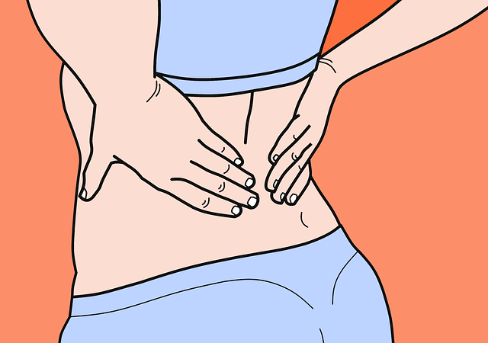
to have …? to get …? to feel … ?
a runny nose toothache
flu’ hot
a temperature a headache
a cold earache
cold toothache
shivery a sore throat
a bruise a blister
backache feverish
dizzy nausea
stomach ache indigestion
a cough hayfever

Slide 4
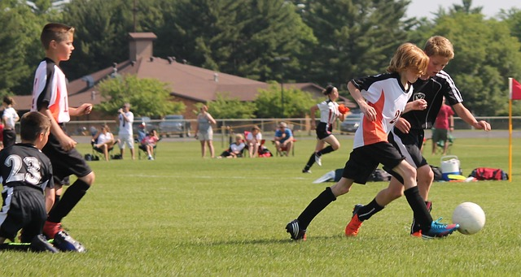
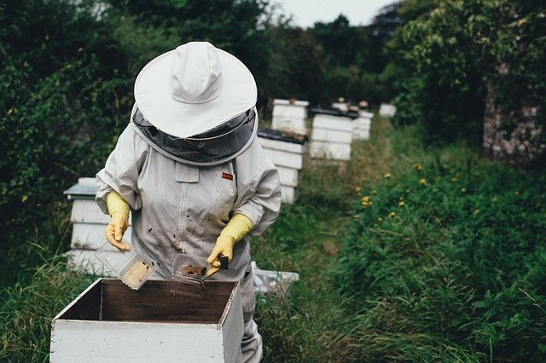
Broken bones, sprains, pulled muscles and pains
I sprained my ankle
I twisted my wrist
I hurt my arm
I’m a bit sunburnt
I banged my head
I burnt my finger
My eye has swollen up
I got stung by a bee
I pulled a muscle running downstairs
I’ve got a pain in my left shoulder
I’ve got a rash on my face
I’ve got a cut on my finger

Slide 5
Reflection:
Who has had a cough, cold or flu’ symptoms recently?
Who has been to the doctor’s or clinic for medical advice?
Who has fallen over, sprained an ankle or even broken a bone, perhaps playing sport? Tell your stories.
Why is it a good idea to keep a written record of this vocabulary?

