Slide 1

Problem Solving
Sexual Harassment

Slide 2



Learning Outcomes
By the end of the lesson, you will have:
a better understanding of what sexual harassment is and how to take action.
learnt more about the #Me Too
campaign.
discussed your views on sexual harassment

Slide 3

What is sexual harassment?

Slide 4
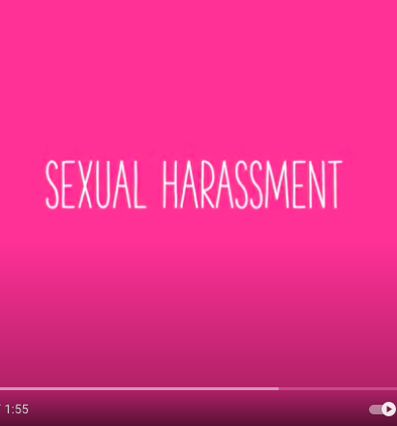
What is sexual harassment?

Slide 5

The Istanbul Convention of the Council of Europe
defines sexual harassment as:
any form of unwanted verbal, non-verbal or physical conduct of a sexual nature with the purpose or effect of violating the dignity of a person, in particular when creating an intimidating, hostile, degrading,
humiliating or offensive environment.¹⁵
Harassment and sexual harassment are also defined in EU Directive 2002/73/EC¹⁶.

Slide 6

#Me Too
What do you know about the #Me Too Movement?
Share what you know with your partner. Make notes in column 1.
You are going to do some research and find out more about this movement. What do you want to know? Write your questions in column 2.
Finally add what you now know about the movement in column 3.

Slide 7




Have Your Say
1.A man cannot be the victim of sexual harassment.
2.The best way to deal with sexual harassment is to ignore it.
3.Sexual harassment between people of the same sex is rare.
4.If a person dresses or behaves in a sexy way, they are asking for attention and have to accept what others say or do.
5.It’s hard to tell the difference between ‘flirting’ and
‘sexual harassment’?.
6.It’s difficult to know what to do if you have been or are being sexually harassed.

Slide 8

Reflection
How similar or different do you think countries around the world view sexual harassment?
How seriously is it taken where you live now? Is it common?
Who do you think is responsible for helping people understand what sexual harassment is?
What advice would you give to someone who is being sexually harassed?

