Slide 1
work
Knowing your rights

Slide 2
Lesson Objectives
By the end of the lesson, you will have:
listened, taken notes on and discussed one woman’s story about being sacked
focused on work - related vocabulary
rewritten the story using the new vocabulary

Slide 3
Mayra’s story
You are going to listen to one person’s story about getting sacked from her job. As you listen, make a note of the answers to the questions below.
1. When she first found the job, Mayra was very happy. What did she like about the job?
2. After a short time, she was unhappy with the job. What was the main problem she had with the job?
3. In what way did Beatriz, the trade union representative feel that the company was being unfair?
4. How did the supervisor respond to Mayra’s explanation of why she couldn’t do overtime?
5. What advice did Beatriz give Mayra the second time she spoke to her?
6. Why did Mayra win the case against the company at the tribunal?

Slide 4
Vocabulary matching
1 shift work
f) a working pattern where employees work different times of the day or night
2 minimum wage
d) the lowest pay per hour almost all workers are entitled to. This varies from country to country.
3 a contract
i) a written, legal agreement between an employer and employee with details of the job, working hours, pay etc.
4 the shop floor
j) the workers (not management) usually in a factory
5 a payslip
h) a document given to employees with details of how much money they will be paid and what tax will be taken off
6 overtime
k) extra time spent working after the usual working hours

Slide 5
Vocabulary matching
7 trade union representative
a) someone from the trade union who represents the employees’ by protecting their rights and discussing their pay and working conditions
8 to sack someone
l) to remove someone from their job because of something they have done
9 unfair dismissal
g) a situation in which a person who has been asked to leave their job believes the decision was unfair
10 a grievance against an organisation or person
b) a complaint that someone has been treated unfairly
11 an employment tribunal
e) a special court that examines complaints about employment between employers and employees
12 compensation
c) money that is paid to someone because they have been treated unfairly

Slide 6
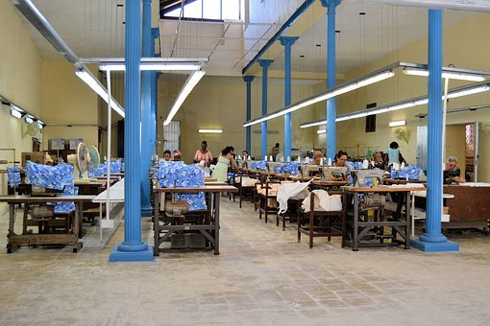
reflection
Do you know anyone who was treated unfairly at work? What was their story? Did they challenge the employer?
Although it can be free to take an employer to an employment tribunal in some places, if you lose the case, you might have to pay the employer’s legal costs. In your opinion, was Mayra right to take the company to an employment tribunal?
What do you know about challenging workers’ rights in different countries? Is it possible to do this in the country you are in now and any other countries that you know?

