Slide 1
Health and Well-being -
A Balanced Diet

Slide 2
Lesson Outcomes
By the end of the lesson you will have:
developed your reading skills
used lots of vocabulary for describing food and what it contains.
been encouraged to make healthier choices when food shopping and menu’ planning.

Slide 3
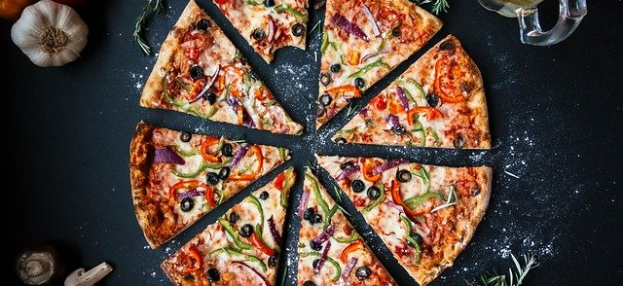
Lunch or dinner? Do you think these meals are lunch or dinner ? What did you have for lunch and dinner yesterday? What did you and your family eat every day when you were young?

Slide 4
WORD CLOUD
Salt sugar starchy foods calories balanced fibre vegetables protein saturated fats unsaturated fats healthy body weight wide variety

Slide 5
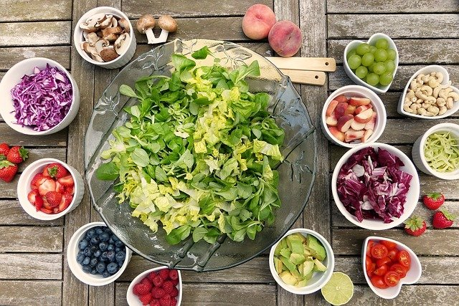
Healthy food: fruit and vegetables
What do you recognise? Do you use any of these foods in recipes?
Which fruit and vegetables do you usually eat at home?

Slide 6
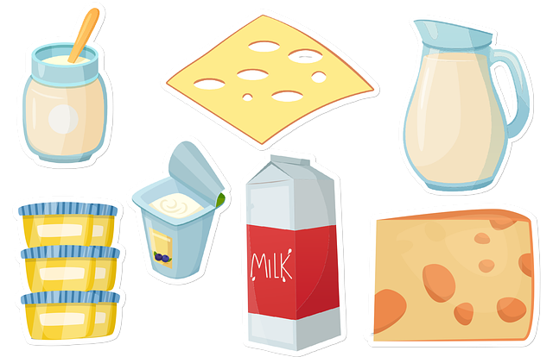
Healthy food: dairy
What do you recognise? Do you use these foods in any recipes?
Which dairy foods do you usually eat at home?

Slide 7
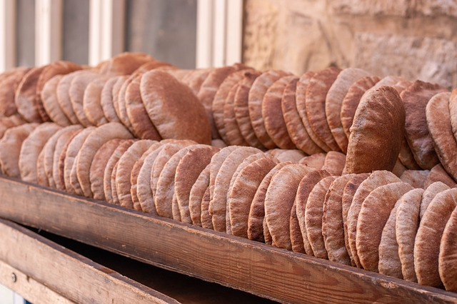
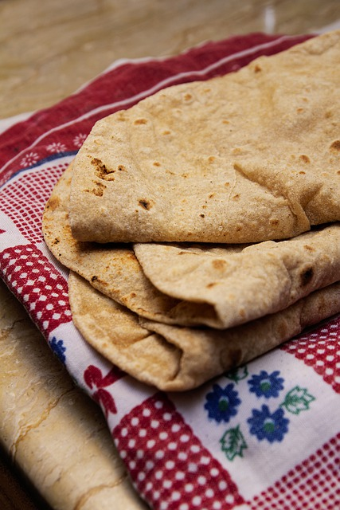
Bread: There are many different types of bread. Which do you recognise? Are they the same or different from what you usually eat?

Slide 8
Activity 3: Now read or listen to the information: https://www.nhs.uk/livewell/eat-well/

Slide 9
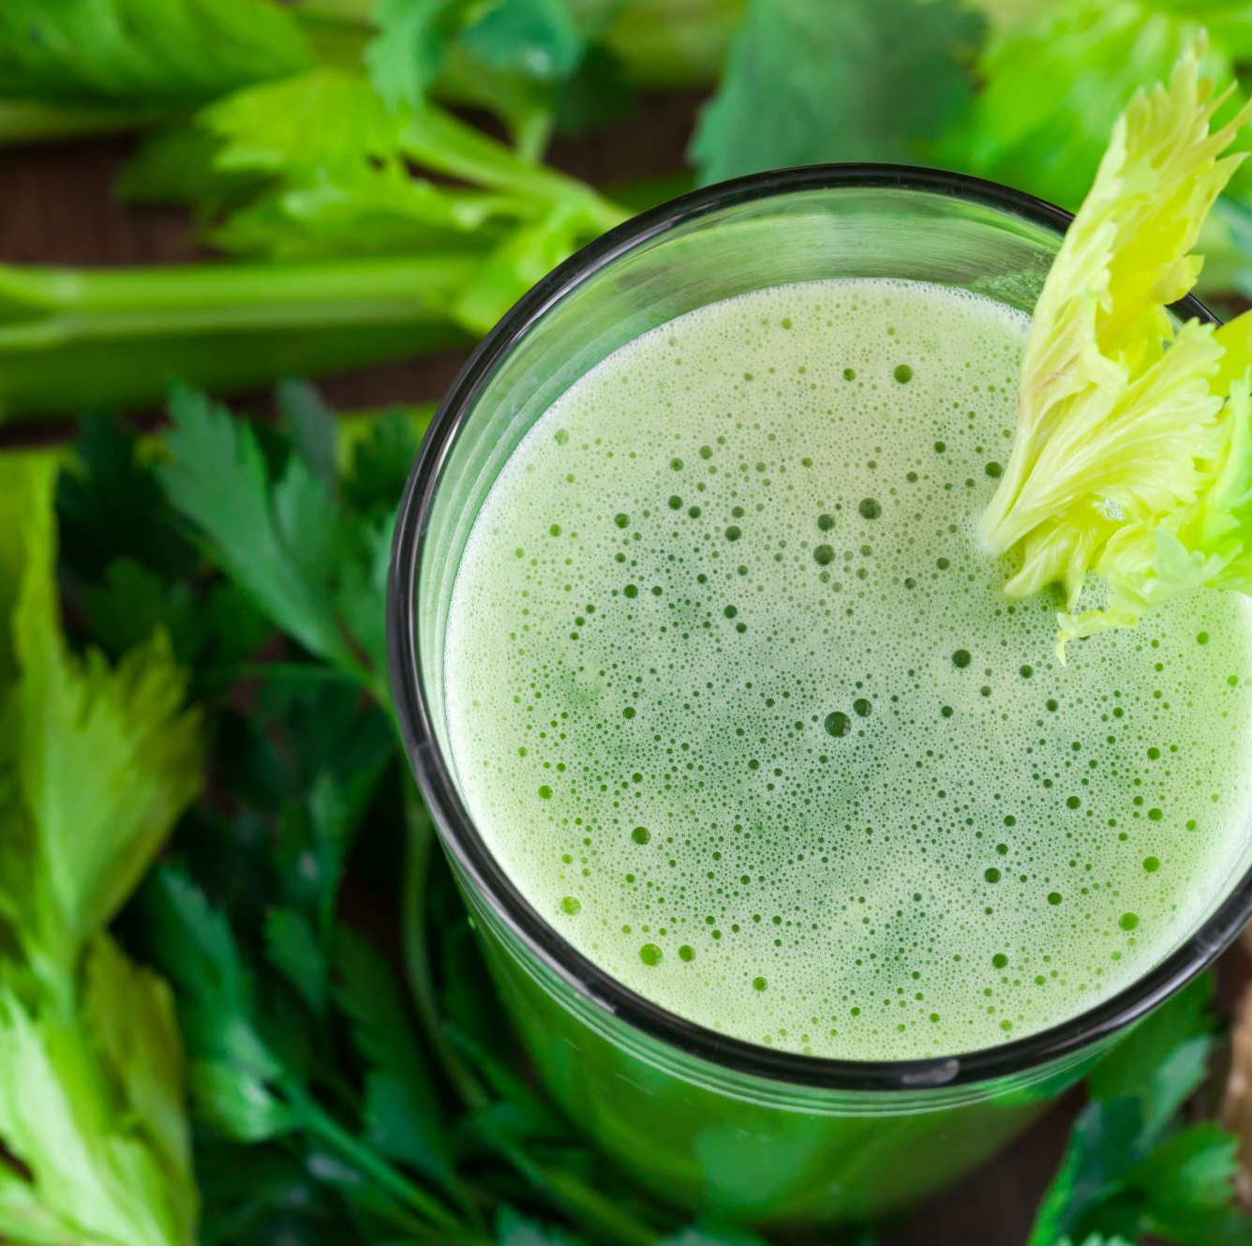
Reflection:
Discuss:
What makes a balanced diet?
Do you eat a balanced diet now?
Did you eat a more balanced diet before?
How could you make your diet more balanced now?

