Slide 1
Health and Well-being -
At the optician’s

Slide 2
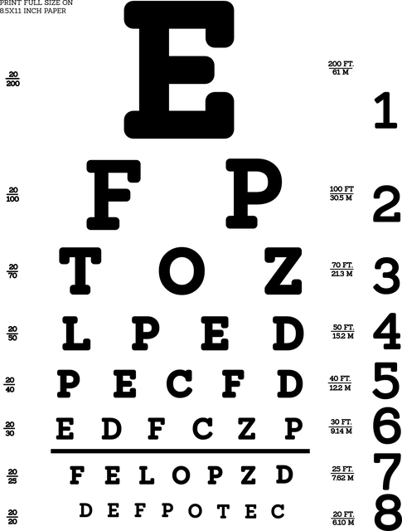
Lesson Outcomes
By the end of the lesson you will have:
understood how to have your eyesight checked.
practised making an appointment.
practised language used during an eye test and at the optician’s.

Slide 3
Optician, optometrist or ophthalmologist?
I need to change my glasses frames.
I must have my eyes tested, I have a bad headache.
I’ve just broken the left “arm” of my glasses.
I stood on my glasses and now they feel strange.
I need glasses for reading and for seeing at a distance.
I think my mother has a cataract on her right eye . She must have it removed.
7. I haven’t had my eyes tested since I was a child. I must make an appointment.
8. I need lenses that are a little bit coloured.
9. I’d like to have a pair of sunglasses with lenses.
10. I need a new pair of frames.
11. My grandfather has glaucoma. He has great difficulty seeing.
12. I’d like lenses which change colour in the sunshine.

Slide 4
Making an Appointment. Listen!

Slide 5
To have something done (the causative passive)
Eg. Tomorrow I’m having my hair cut. Someone else is doing the work (the hairdresser/barber) and the action (cutting) is more important than the subject (I).
Eg 2. We had our bicycles oiled and greased last week. Someone else did the work (the mechanic) and the action (oiling and greasing) is more important than the subject (we).
Eg 3. He has just had his documents renewed. Someone else did the work (the local authorities) and the action (renewing) is more important than the subject (he).
Form: to have (conjugated according to time) + object + past participle of verb.
I’m having + my hair + cut
We had + the car + checked
Find the examples in the lesson and explain them to the teacher.

Slide 6
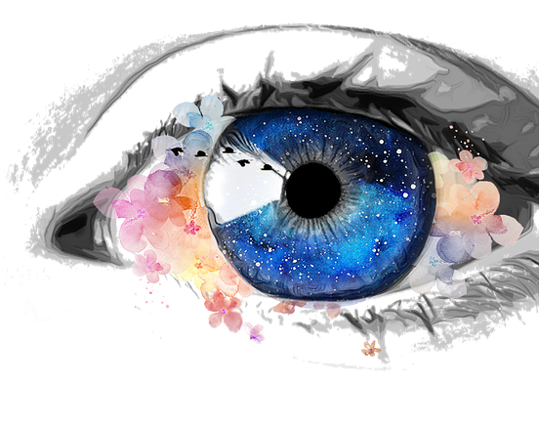
Reflection
How has this lesson helped you to understand:
~ where to have your eyesight checked. ~ why it’s important.
Look around the area where you live for a local optician or optometrist.

