Slide 1
Health and Well-being -
Breakfast Recipes

Slide 2
Lesson outcomes:
By the end of the lesson you will have:
practised food vocabulary
noticed how recipe methods are expressed in English
written your own recipes using the same linguistic style
understood more about each other’s lifestyles

Slide 3
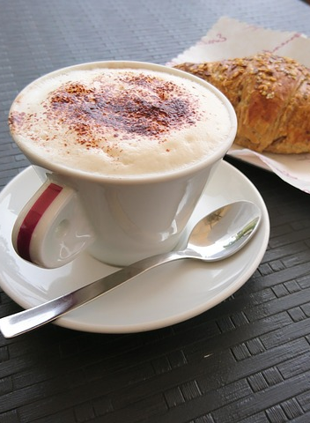
BREAKFAST AROUND THE WORLD Activity 1

Slide 4
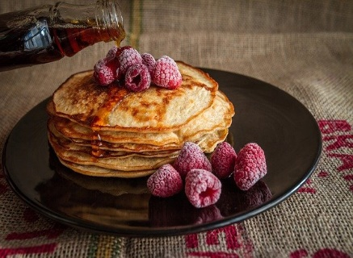
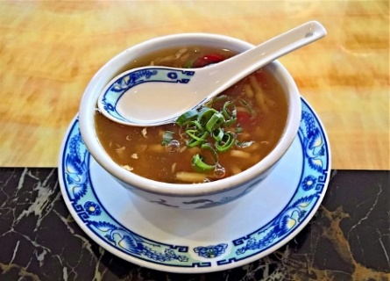
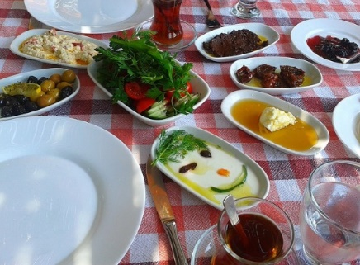
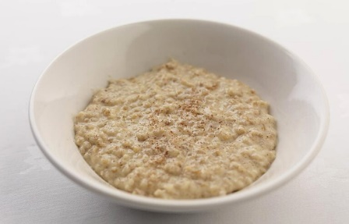
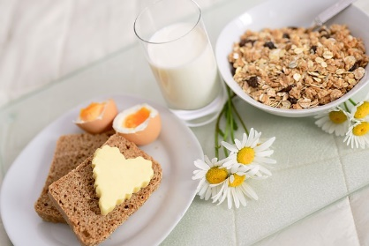
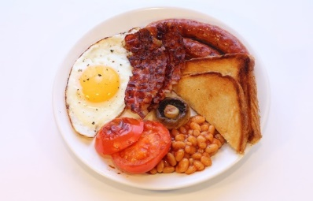
Where do you think these breakfasts are from?

Slide 5
Where do you think these breakfasts are from? POSSIBLE ANSWERS
Top row left to right:
USA, China, Turkey, Scotland (or Ireland)
Bottom row left to right:
England (or Scotland or Ireland), France, Germany, Austria (or Germany).
nb. Muesli is usually offered in European hotels for breakfast.

Slide 6
Activity 3: Recipe
Ingredients
I egg per person
2 tablespoons milk
Knob of butter
Quarter teaspoon salt
Shake of pepper
Saucepan
Spoon
Fork
Small bowl
Source: bingonline

Slide 7
Put the method into the correct order
A. Place the pan on the lowest heat possible and put knob of butter in.
B. First of all, break the egg into the bowl and add the milk salt and pepper.
C. As soon as the egg in the pan is thick and there is almost no liquid egg left, turn off the heat.
D. Now keep stirring. The heat in the pan will cook the egg to the right consistency.
E. Then stir the butter around the pan.
F. After that beat the egg gently just to mix the ingredients.
G. As soon as the butter starts to melt, pour in the egg.
H. Keep stirring the egg in the pan with a spoon to mix the cooked egg with the uncooked part.
I. Finally add salt and pepper to taste.

Slide 8
SCRAMBLED EGGS
Answers:
B
F
A
E
G
H
C
D
I

Slide 9
Reflection:
Are the dishes similar or different?
Which ones would you like to taste? Why?
Which ones wouldn’t you like to taste? Why not?
Compare the breakfast in this country and another country.
Which do you prefer? Why?
Choose a favourite dish.

