Slide 1
Problem Solving
Getting and Giving Advice

Slide 2
Learning Outcomes
By the end of the lesson you will have:
looked at different ways to deal with a variety of different problems
explored some of the places and people you can go to for help
practised giving each other advice

Slide 3
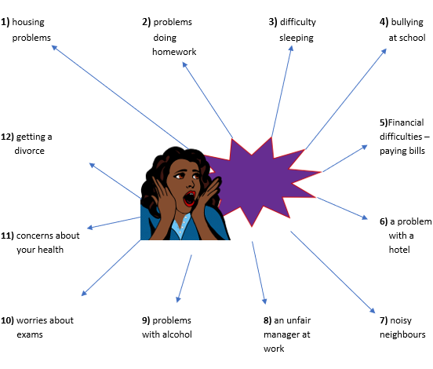
Look at the mind map and decide who is likely to have this problem.
a) somebody under 18 b) somebody over 18 c) anybody

Slide 4
What’s the best option?
Problem The air-conditioning in the flat you are renting stopped working six weeks ago. Your landlord told you he would have it repaired within a week. He never did and whenever you contact him he keeps promising he will. The weather is beginning to get very hot. What do you do? | Advice Stop paying your rent till the air conditioning has been repaired. b) Contact your local council and inform them of the problem. c) Pay to have the heating repaired and give your landlord the bill.

Slide 5
What’s the best option?
Problem You paid to do a course at your local college. The teacher has missed several classes already in the first month. When he has come in, he regularly arrives late, he rarely gives any homework and does not appear to care very much about his students. What do you do? | Advice Tell your lecturer that if the lessons do not improve, you will leave. b) Speak to the Head of Department (the lecturer’s manager). c) Demand the your course fees back.

Slide 6
What’s the best option?
Problem You booked a flight from Madrid to Brasilia. The original flight required a transfer in Sao Paolo on the same day. The airline changed the flight and you now have to stay overnight. The airline has told you it is your responsibility to arrange your accommodation. | Advice Cancel your flight and book with another airline. b) Insist the airline pays for your hotel. c) Contact your insurance company to see if they will cover the hotel costs.

Slide 7
Language Box: Giving advice (I reckon / think) you should… e.g. I reckon you should refuse to pay any more rent until your landlord repairs the air-conditioning Why don’t you + bare infinitive e.g. Why don’t you find out whether there is a school counsellor you can speak to If I were you, I’d + bare infinitive e.g. If I were you, I’d pay to have the air-conditioning repaired and invoice your landlord. I’d strongly advise you to + + bare infinitive e.g. I’d strongly advise you to ring the police | Responding to advice That’s a (really) good idea. Yes, you’re right. I’ll try that. I’ve already tried that. (Have you got) any other suggestions?

Slide 8
Reflection
Do you think the places you go to get help are different in different countries?
Why? Why not?
How can you find out about the different places to get help in the country where you live now?

