Slide 1
Problem-solving
Organising a sports tournament
Football and food

Slide 2
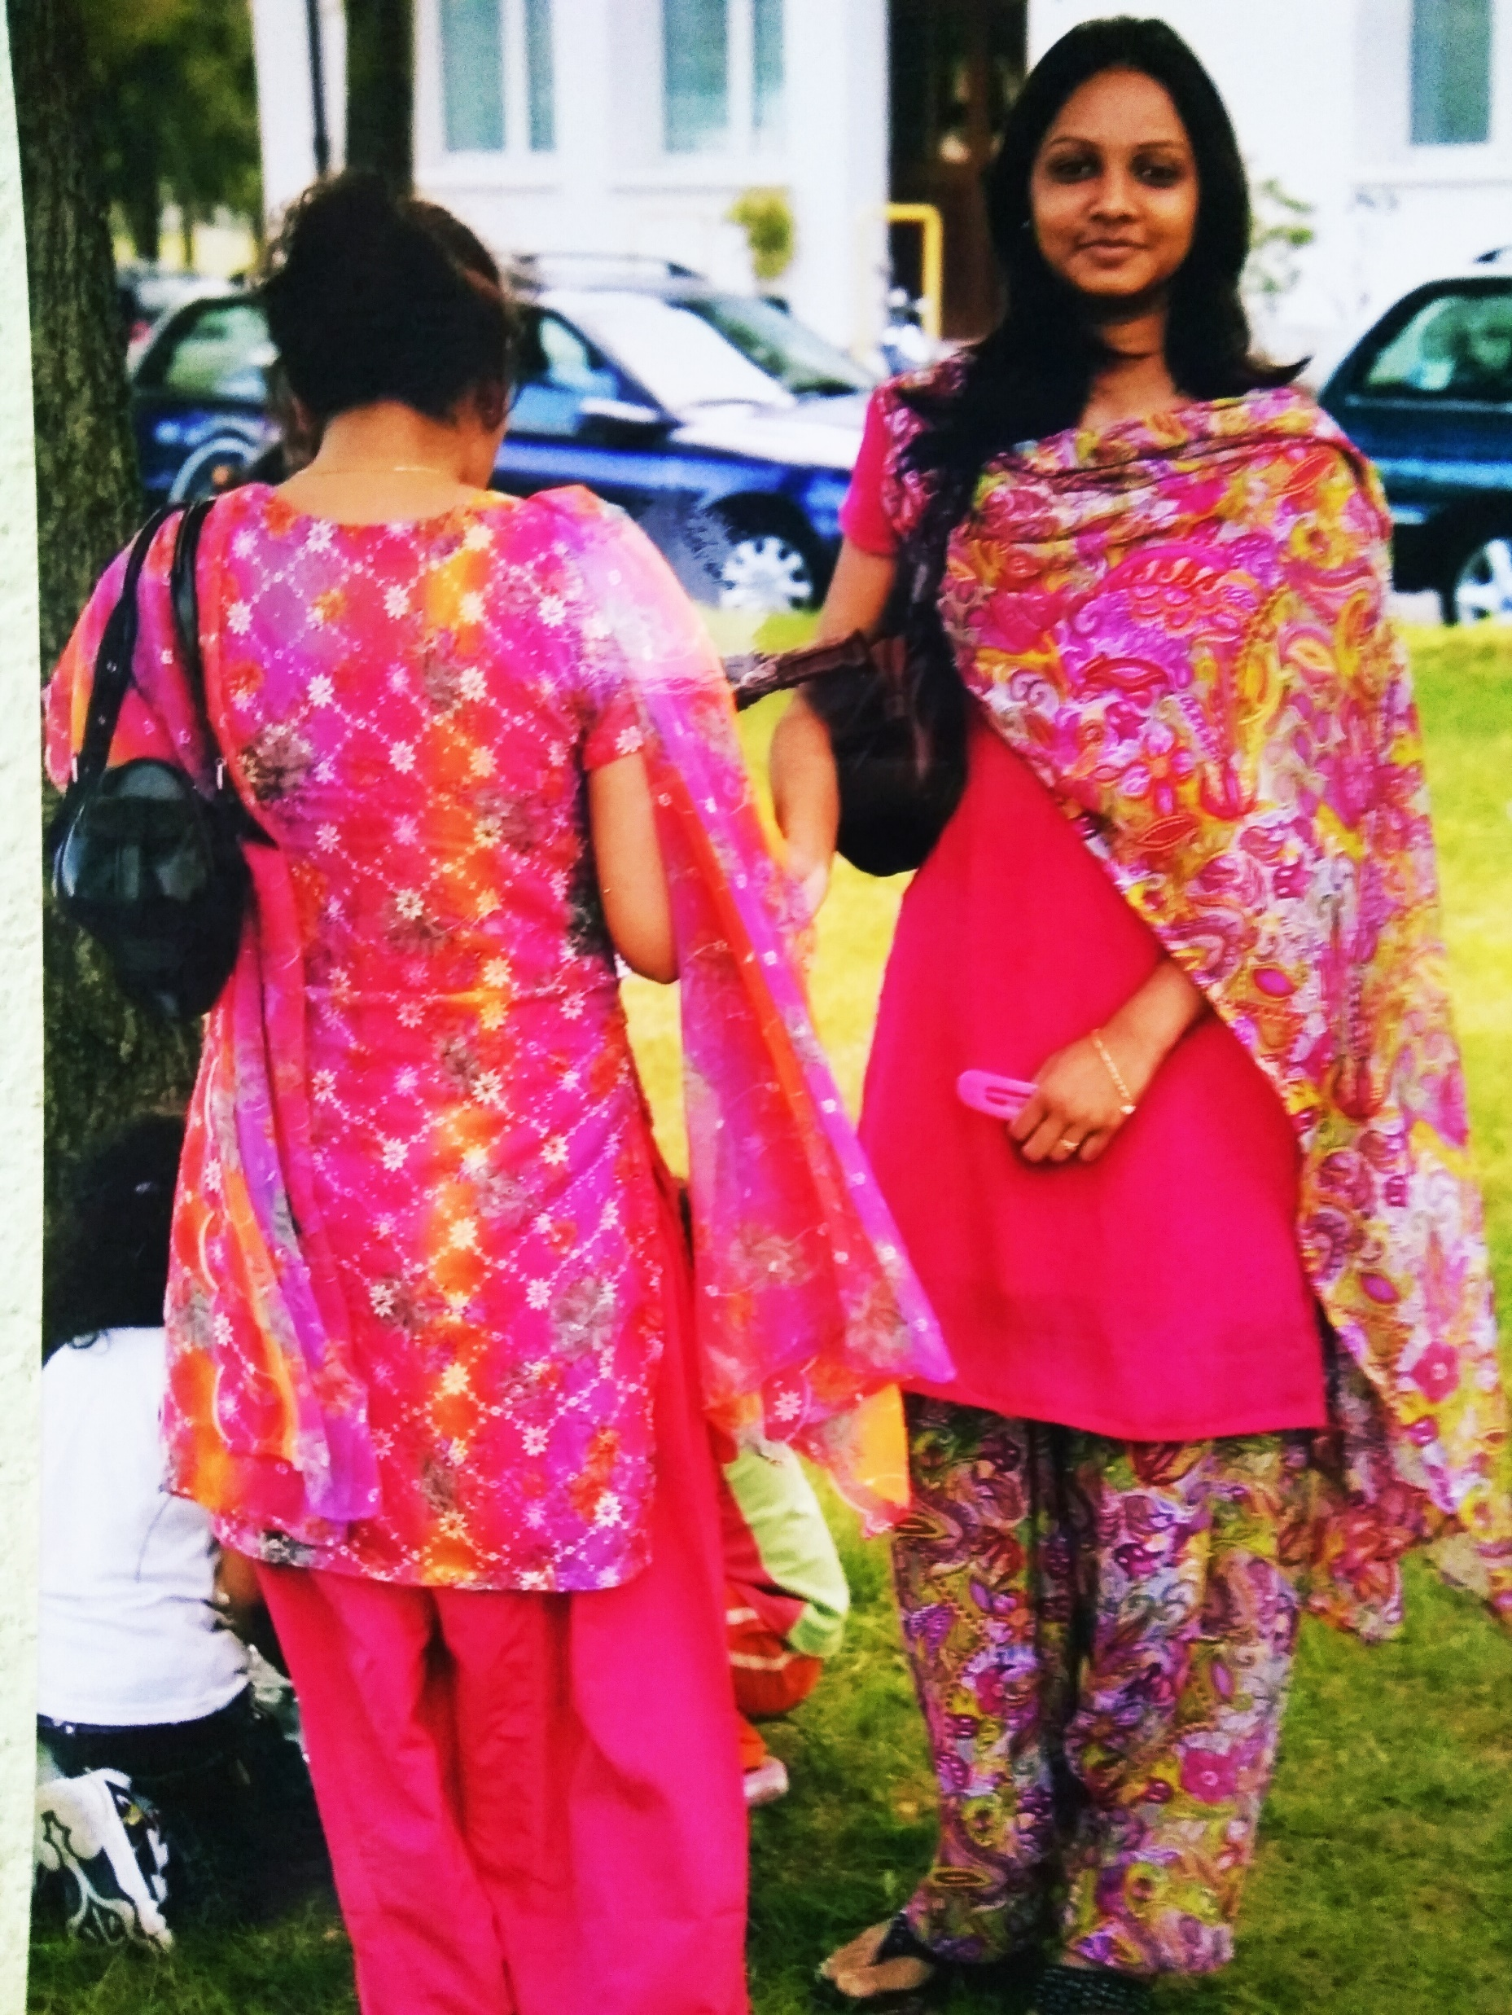
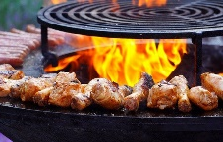
Lesson outcomes:
By the end of the lesson you will have:
understood how to organise successfully a multi-ethnic sports tournament.
become aware of the possible hidden or unsuspected difficulties.
listened to and read witness statements.

Slide 3
Background:
The sports club “Dai un calcio al Razzismo” (Let’s kick out racism), organised a winter football tournament in a local leisure centre, followed by dinner together.
Each group had to bring a national dish to share. Advertising was by word of mouth.
There were 5 teams.
An Afgan boy organised the cooking.
Romanian boys did the serving.

Slide 4
Background to the tournament: The decision to link football and food. Listen to Lino.
This Photo by Unknown Author is licensed under CC BY-NC

Slide 5
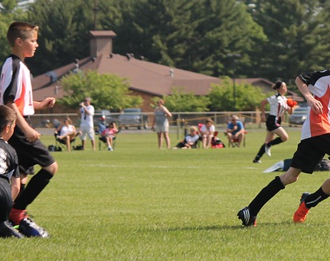
Organising:
Think about:
Where to hold the tournament, who to contact and the cost.
Who will take part?
Who will you contact to find amateur groups of footballers.
At the sports ground or sports hall, is there space to sit and eat? Is there a kitchen/barbecue area?
Who will you ask to collaborate with the project?
How will you find out how to apply for funding?
How will you organise dinner together at the end?
What difficulties could there be?

Slide 6
What went wrong: the issues. Listen to Mick: 1.FandF and 2.issues

Slide 7
Reflection:
Discuss all together:
Is sport an effective way to encourage integration? Why? Why not?
What other suggestions do students have to encourage integration?

