Slide 1
Relationships
Let’s Talk about Sex

Slide 2
Learning Outcomes
By the end of the lesson, you will have:
looked at some words associated with sex
read what different young people think about sex
shared your views on sex

Slide 3
Which words do you associate with sex?
safe fun underage
unprotected
consent steady relationship
peer pressure trust
STIs casual contraception
getting pregnant

Slide 4
Complete the sentences.
I don’t mind talking about sex with…
because…
There’s no way I’d talk to… about sex
because...
The only person/ people I feel really
comfortable talking about sex with is/ are… because….
4. Generally speaking I feel/ don’t feel
comfortable talking about sex because…

Slide 5
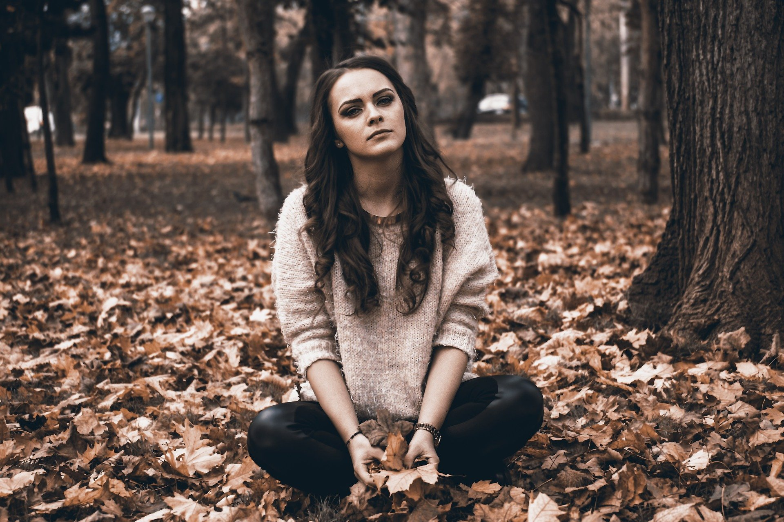
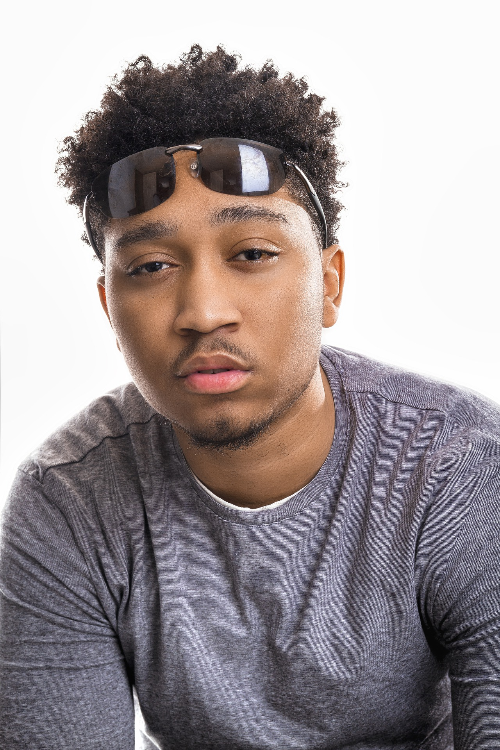
Four different views
1. Who is concerned about what other people think?
2. Who isn’t concerned about what other people think?
1. Gabriele, Tekle 2. Nicoletta, Ekaterina

Slide 6
What do I think about sex?
I’m not in a relationship with anyone but if I meet someone really hot, for example at a party, I might end up having sex with them. I’ve been with guys and girls. I don’t think there’s anything wrong with that. I know some people probably think I’m an easy lay, but I don’t think there’s anything wrong with what I do. Let them think what they think. I’m 18 and proud to be sexually active.
Nicoleta

Slide 7
What do I think about sex?
I’m seeing a girl at college. We’ve been together for a few months. We didn’t have sex for a while and her parents talked to her about taking it slowly. I just didn’t want her to feel like I was hassling her into having sex, but it does feel right because we’re in a steady relationship. If she’d wanted to wait that would have been fine with me.
Gabriele

Slide 8
What do I think about sex?
I’ve known I’ve liked boys for years and coming out was the hardest thing I ever had to do. My friends said they already knew but my parents still refuse to accept I am gay. They just don’t get it. Most people in our community think it is wrong and think I have some kind of disease. They think I need to be cured. I’m not really accepted by my community anymore which makes me really sad. I just wish they would understand me and accept me for who I am.
Tekle
What do I think about sex?

Slide 9
What do I think about sex?
I feel a lot of pressure when I go out. My friends make jokes and think I’m frigid, and they don’t understand why I won’t sleep with anyone. I just don’t want to. It doesn’t bother me if they don’t understand. I think I’m probably the only person in my class who hasn’t had sex. It makes me feel quite special and proud. I’m in no rush to have sex with the first person I see.
Ekaterina
What do I think about sex?

Slide 10
Reflection
How important do you think it is to talk about sex? Why? When should we start talking about sex?
People have different views of sex. How do you feel about people not sharing your views? How easy will it be for you to accept what other people say or think about sex?
If you wanted to talk about sex or needed some advice, do you know who you could speak to or where you could go?
.

