Slide 1
Agitu Gudeta
a symbol of integration

Slide 2
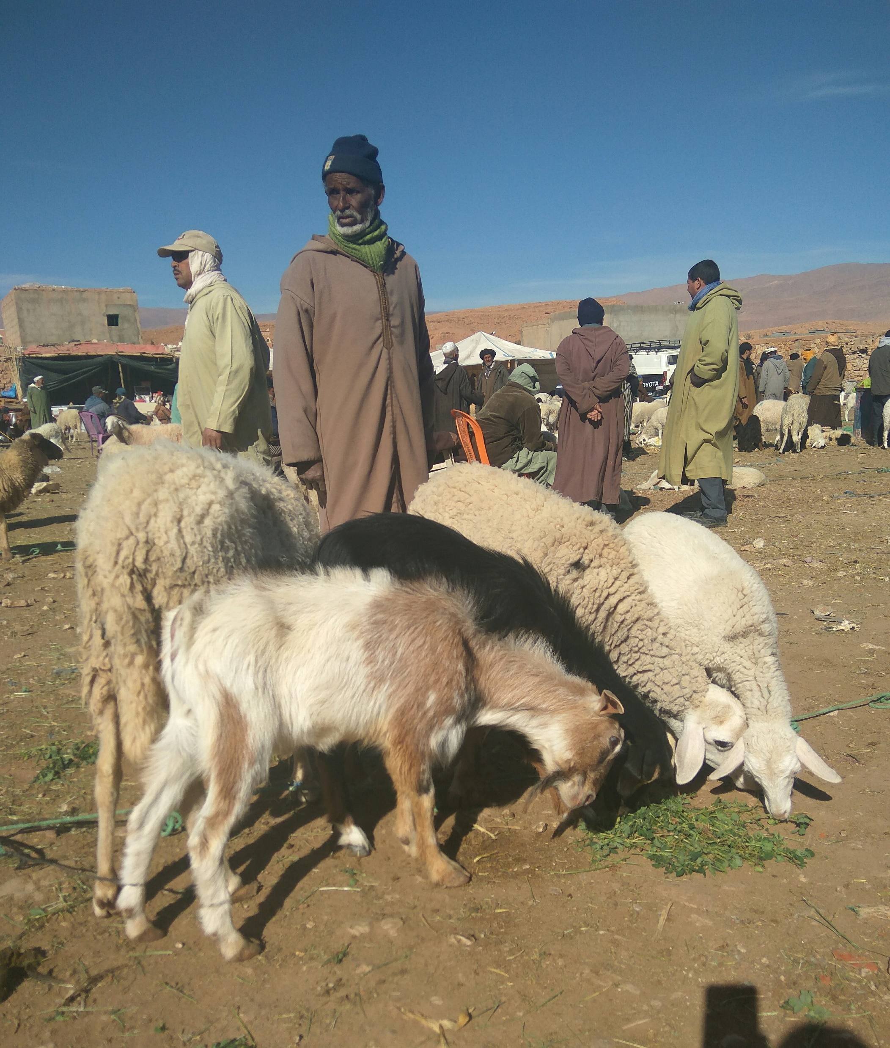
Lesson Outcomes
By the end of the lesson you will have:
discussed the reasons why people leave their country.
read the story of an enterprising Ethiopian immigrant.
created a commentary to accompany a short video about her life.

Slide 3
Agitu Gudeta
“An Ethiopian migrant has become a symbol of integration in Italy her adopted home. She escaped from Addis Ababa after her participation in protests against “land-grabbing” angered local authorities. She has created a successful animal farm and business”
Who is Agitu Gudeta?
Why did she leave her country?
Where did she go?
How do you think the story will continue?

Slide 4
Read and put in order
Paragraph Z She escaped from Addis Ababa in 2010 after her participation in protests against “land-grabbing” angered local authorities. Activists accused the authorities of setting aside large areas of farmland for foreign investors, especially to grow flowers, maize, sugar cane and produce palm oil for export.
Paragraph Q She started with 15 goats, a local breed called Pezzata Mochena, and by 2018 she had 180, becoming a well-known local figure. “I created my space and made myself known, there was no resistance to me” she said. There was no racism or hostility towards her. “I’ve always worked, was self-sufficient, never needed to ask for anything. I was independent. People respect that.”
Paragraph K In fact, Gudeta’s story has been reported by numerous international media as an example of a migrant success story in Italy at a time of rising hostility towards immigrants, fuelled by the right wing Lega party. Agitu grew up in the Ethiopian capital of Addis Ababa.
Paragraph J After leaving Ethiopia, when she reached Italy, at first she felt afraid and indecisive. She had contacts in Trento so she went there. She was able to use common land in the northern mountains to build her new enterprise, taking advantage of permits that give farmers access to public land to prevent unclaimed territory from being reclaimed by Mother Nature.
Paragraph X An Ethiopian migrant has become a symbol of integration in Italy, her adopted home, where she keeps goats and has a successful cheese business. Agitu Gudeta, has made her home in the mountains of Trentino’s Valle dei Mocheni, making goat’s cheese and beauty products on her farm La Capra Felice (The Happy Goat), which was built on previously abandoned land.

Slide 5
The right order
Paragraph X An Ethiopian migrant has become a symbol of integration in Italy, her adopted home, where she keeps goats and has a successful cheese business. Agitu Gudeta, has made her home in the mountains of Trentino’s Valle dei Mocheni, making goat’s cheese and beauty products on her farm La Capra Felice (The Happy Goat), which was built on previously abandoned land.
Paragraph K In fact, Gudeta’s story has been reported by numerous international media as an example of a migrant success story in Italy at a time of rising hostility towards immigrants, fuelled by the right wing Lega party. Agitu grew up in the Ethiopian capital of Addis Ababa.
Paragraph Z She escaped from Addis Ababa in 2010 after her participation in protests against “land-grabbing” angered local authorities. Activists accused the authorities of setting aside large areas of farmland for foreign investors, especially to grow flowers, maize, sugar cane and produce palm oil for export.
Paragraph J After leaving Ethiopia, when she reached Italy, at first she felt afraid and indecisive. She had contacts in Trento so she went there. She was able to use common land in the northern mountains to build her new enterprise, taking advantage of permits that give farmers access to public land to prevent unclaimed territory from being reclaimed by Mother Nature.
Paragraph Q She started with 15 goats, a local breed called Pezzata Mochena, and by 2018 she had 180, becoming a well-known local figure. “I created my space and made myself known, there was no resistance to me” she said. There was no racism or hostility towards her. “I’ve always worked, was self-sufficient, never needed to ask for anything. I was independent. People respect that.”

Slide 6
Watch!!
https://youtu.be/40RRuQbpYQQ

Slide 7
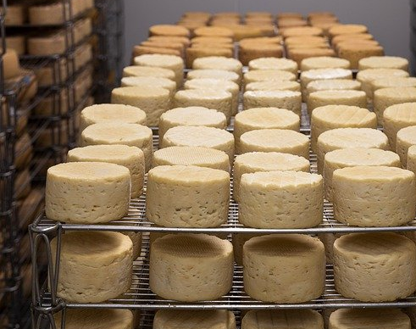
Reflection
What do you think about Agitu and the life she has created for herself?
Could you do something similar? Why? Why not?
Is there a reason she has never experienced racism or aggression by the local people? What do you think?

