Slide 1
Work
The Gig Economy

Slide 2
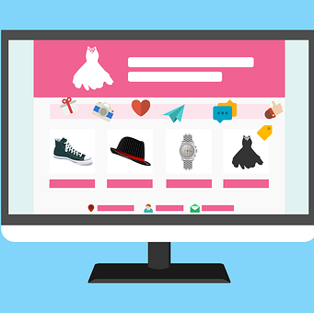
Learning Outcomes
By the end of the lesson, you will have:
discussed your experiences of the gig economy
watched a video explaining the key features of the Gig Economy
read about people’s experiences of working in the Gig Economy and considered the advantages and disadvantages

Slide 3
Your Experiences
Look at the quote. Can you explain it?
"Uber, the world’s largest taxi company, owns no vehicles. Facebook, the world’s most popular media owner, creates no content. Alibaba, the most valuable retailer, has no inventory. And Airbnb, the world’s largest accommodation provider, owns no real estate." Tom Goodwin
Look at the quote. Can you explain it?
What experience do you have of Uber, Facebook, Alibaba (or Amazon) or AirbnB?
Do you / have you used any of these companies? Has your experience been generally positive or negative? Do you know anyone who works for any of them? Has their experience been generally positive or negative?

Slide 4
The Gig Economy
insurance waiters permanent specified temporary accountants payroll unspecified
a What do you know about the Gig Economy? Watch the video and fill in the gaps using the words in the box.
A gig is a job for a ____________________ period of time.
A gig economy is a free market system in which ___________ positions are common.
Gig workers could be ____________________ photographers, handymen or dog walkers.
Gig workers are not on a company’s ____________________.

Slide 5
b Look at the statements below. Circle the best option. Watch the video to check your answers.
Employers / workers don’t have to pay for any training.
Employers / workers have an improved work-life balance.
Employers / workers only do the work they are really interested in.
Employers / workers don’t need to provide office space.
Employers / workers don’t get any sickness or retirement benefits.
Employers / workers have to pay for their own equipment.
Employers / workers can work from anywhere in the world.
Employers don’t have to pay for any training.
Workers have an improved work-life balance.
Workers only do the work they are really interested in.
Employers don’t need to provide office space.
Workers don’t get any sickness or retirement benefits.
Workers have to pay for their own equipment.
Workers can work from anywhere in the world.

Slide 6
Working in the Gig Economy
a Read the case study your teacher gives you. Is the person you are reading about generally positive or negative about working in the Gig Economy? What are their future plans? Why?
Note the advantages and disadvantages they mention in the table.

Slide 7
Working in the Gig Economy Pedrag
Advantages
flexible – can work whenever he wants
no boss
pays less tax now than he did before
has learnt a lot of new skills
plenty of work
Disadvantages
has to organise his own tax
no paid holiday or sick pay

Slide 8
Working in the Gig Economy Gabriella
Advantages
flexible – can work whenever she wants
can work for different companies
already has a bicycle so no extra expenses
Disadvantages
only gets paid for the job she does not an hourly rate
no guarantee of work – a lot of people competing for the same work
often works very early in the morning or late at night which is very tiring
sometimes works in the rain and gets ill but no sick pay so has to work even though she’s sick
has no colleagues

Slide 9
Reflection
Agree or disagree?
i) In the future, more and more people and companies are going to be part of the Gig Economy.
ii) The Gig Economy benefits employers more than workers.
iii) There are more advantages than disadvantages in working in the Gig Economy
iv) In the future I plan to work in the Gig Economy.

