Slide 1
Problem-solving
Organising a
cricket tournament

Slide 2
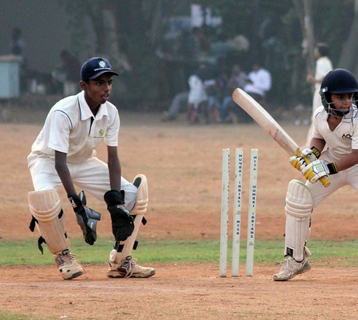
Lesson Outcomes
By the end of the lesson you will have:
understood how to organise successfully a cricket tournament.
become aware of special requirements.
listened to one of the organisers.

Slide 4
Comprehension Check. Choose the best answer.
One essential requirement for this tournament was to have plenty of: a) time b) space c) players d) light
If you organise a tournament in a public place you must have: a) verbal authorisation b) written permission c) a spoken agreement d) verbal permission
A cricket team usually has 11 players. How many players per team did Tanveer decide to have in this tournament? a) 15 b) 10 c) 8 d) we don’t know
4. A cricket match can take a long time. How long did each of these matches last? a) 30 minutes b) 50 minutes c) one hour d) one and a half hours
5. The Bangladeshi supporters were: a) noisy b) colourful and enthusiastic c) hungry and thirsty d) noisy and indisciplined
6. What was the pleasant surprise? a) Tanveer’s team won b) one of the teams was mixed (both men and women) c) some teams were colourful d) some of the supporters cooked food.

Slide 5
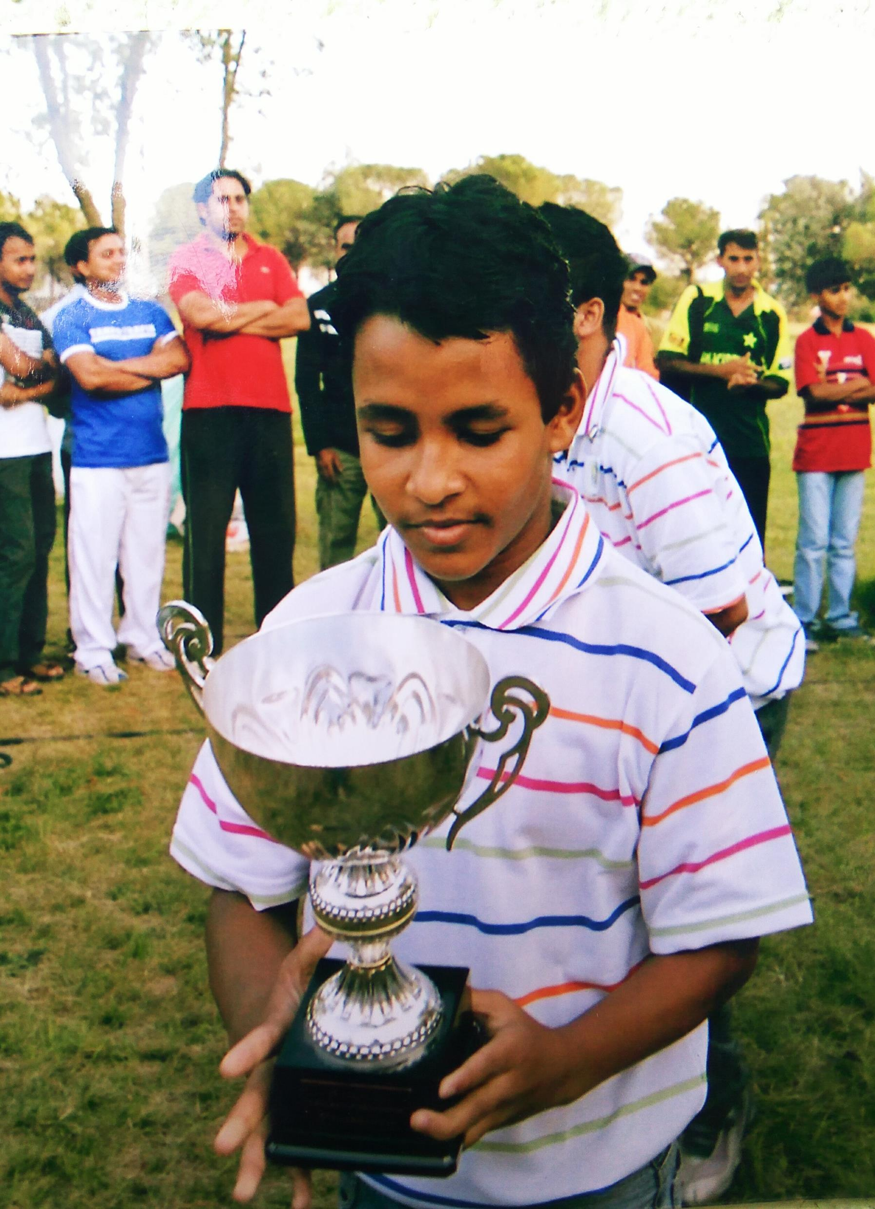
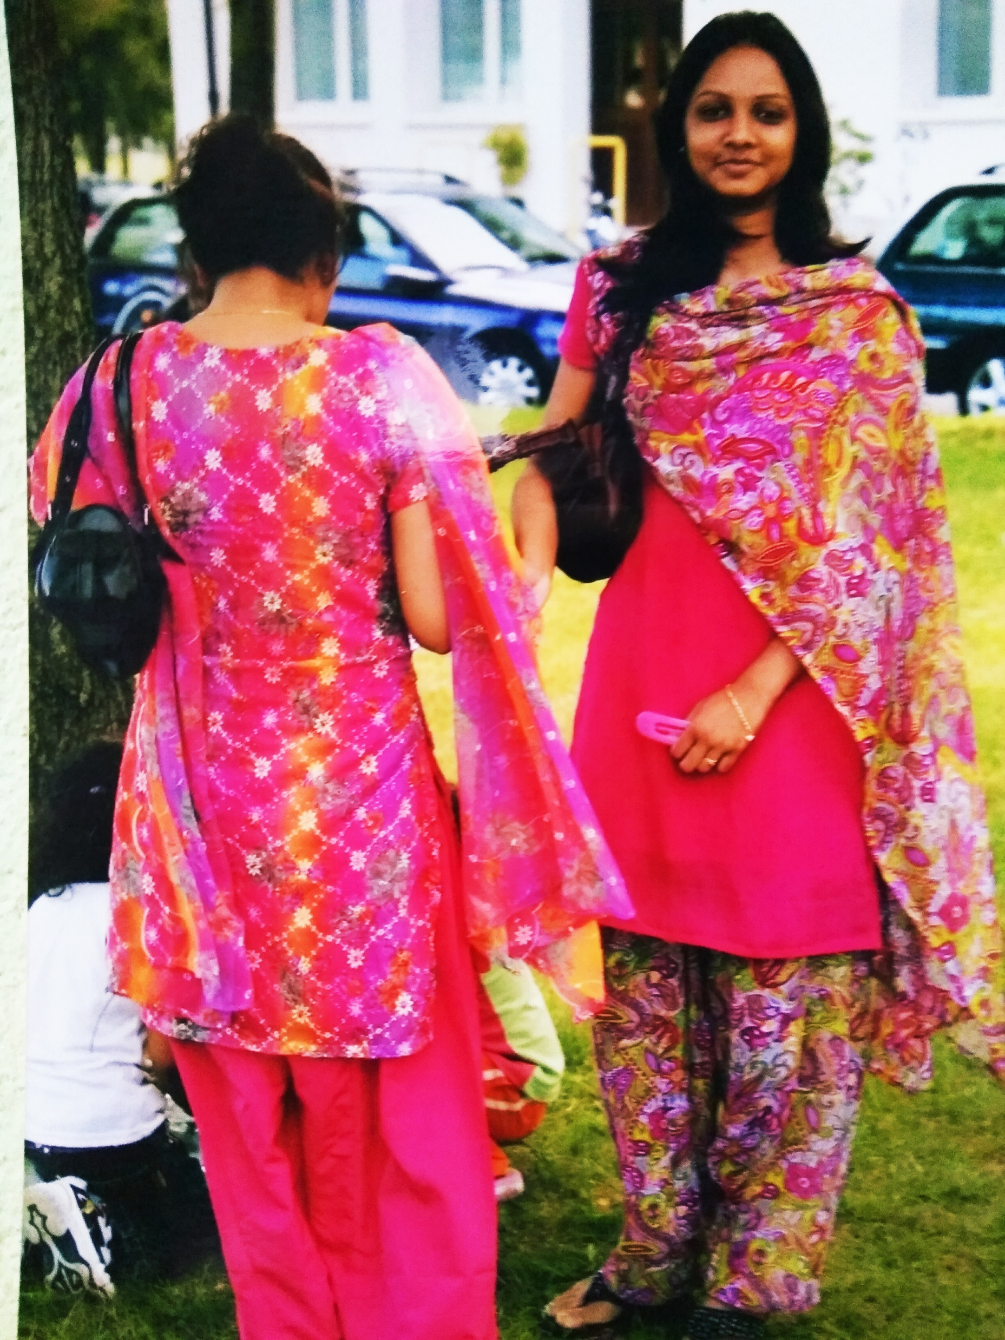
Reflection
Is sport an effective way to encourage friendship and integration?
Why? Why not?
What other suggestions do you have to encourage integration and making friends?

