Slide 1
Communication
Being a Good Listener

Slide 2
Lesson Objectives
By the end of the lesson you will have:
considered who has and hasn’t listened to you in your life
given advice on how to be a good listener

Slide 3
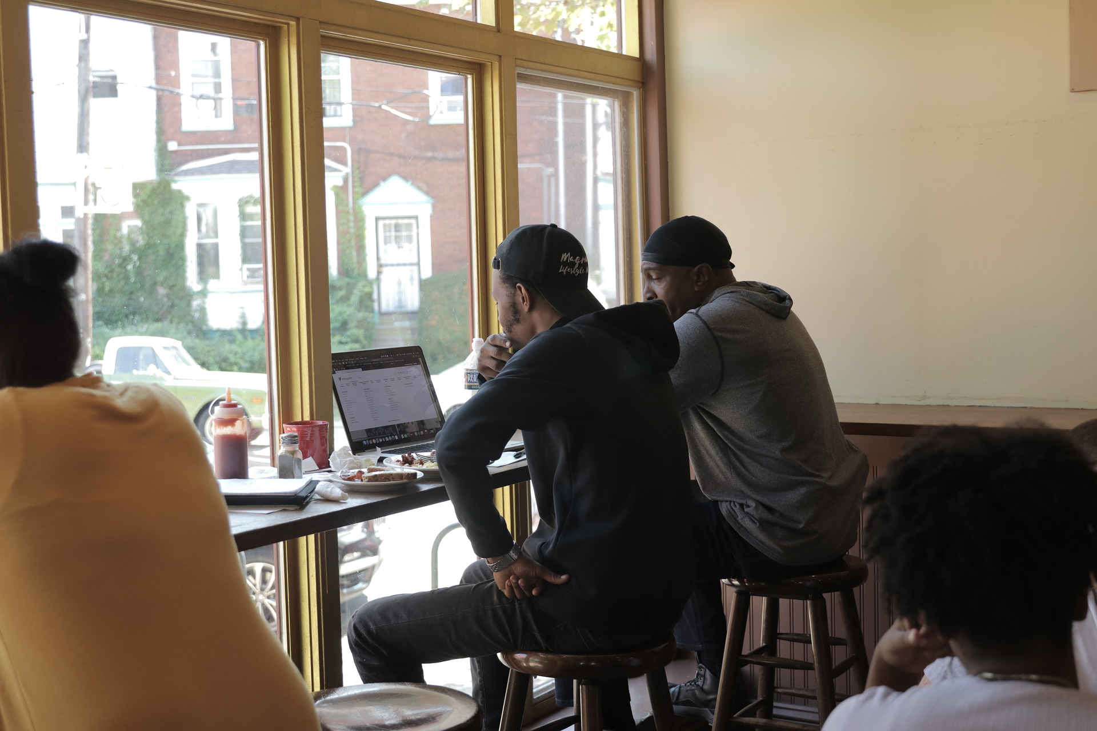
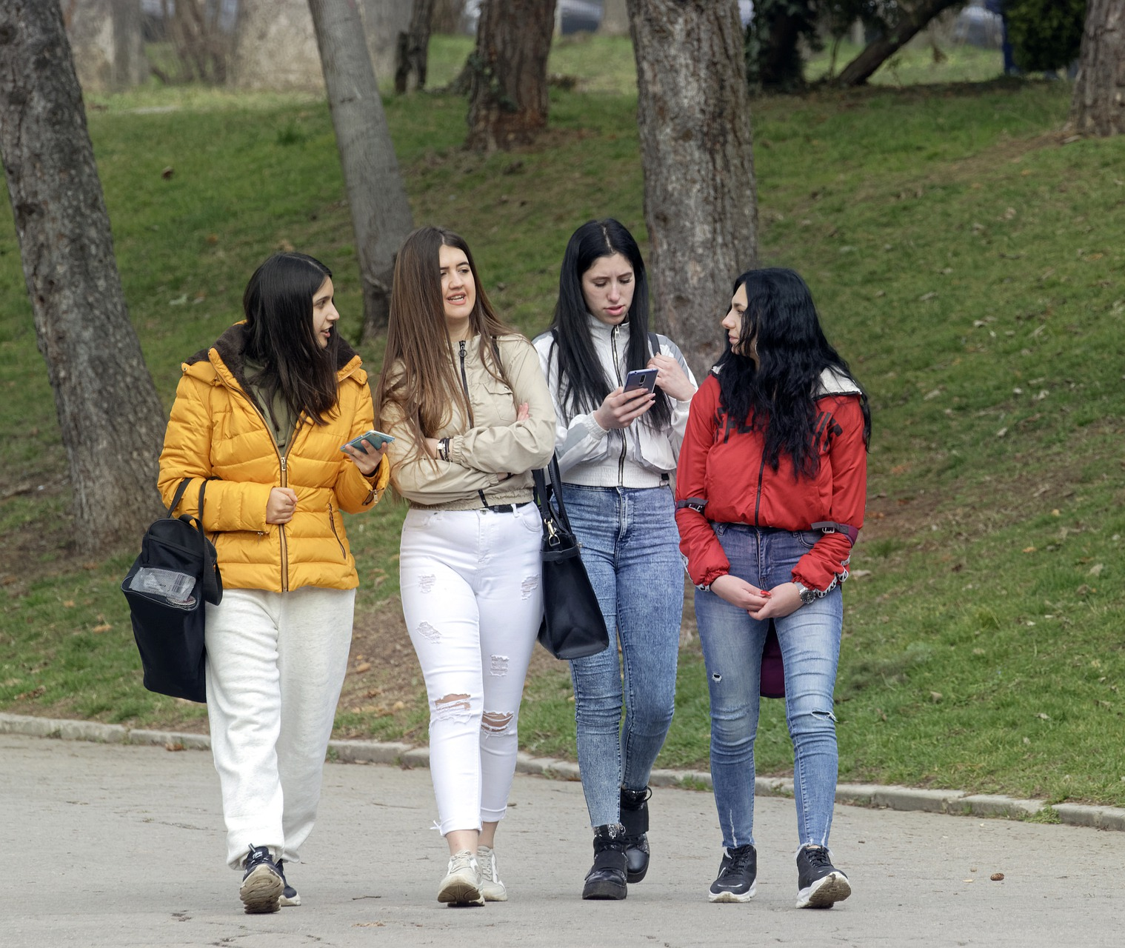
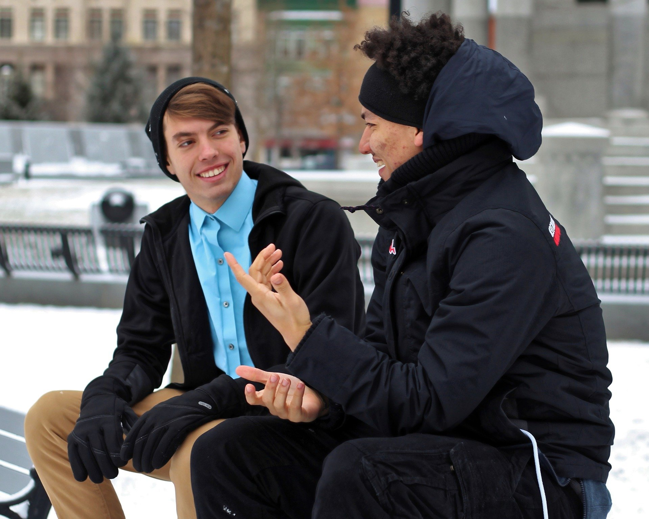
Good or bad listeners?

Slide 4
What influences the way we listen to each other?
language skills
REASONS FOR LISTENING
INTEREST LEVELS
THE environment
RELATIONSHIPS
CULTURAL BACKGROUND

Slide 5
Giving Advice
I think good listeners should…
I don’t think think good listeners should...
I’m not sure but I think..
I suppose good listeners could...

Slide 6
Good listening
Do
Don’t

