Slide 1
Relationships
Dating

Slide 2
Learning Outcomes
By the end of the lesson, you will have:
thought about different types of relationships
considered how you might advise somebody who is going on a date
read dating profiles, matched people and decided on a date location
thought about different things involved in dating

Slide 3
Types of Relationships
What experience do you or anyone you know have of the different types of relationships?
long-distance
long-term
committed
relationships
casual/open
monogamous
dating

Slide 4
Advising your friend
You get a text from your friend; they’re going on a date this evening with someone they met on a dating app.
What advice can you give?
How would you reply to them?

Slide 5
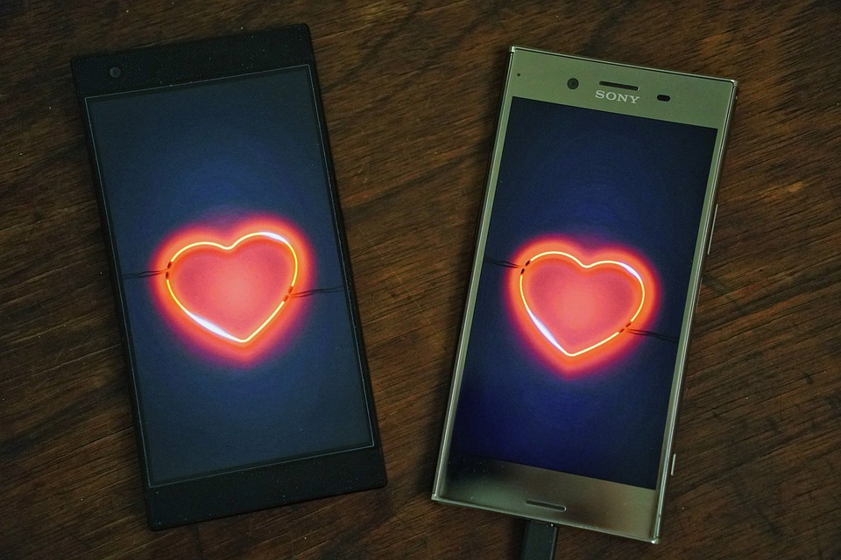
Matching couples
You are going to be given 6 different dating app profiles.
Which people would you put together to go on a date? Why?
Where would they go on their first date? Why?
Glossary words:
monogamous
red flag
swiping
long-term relationship
open relationship
long distance relationship
single parent
casual relationship
be intimate with sby
go home with sby
self-conscious
serial dater
click with sby
see someone
cheating

Slide 6
Should parents be involved in choosing who their children date and/or their long-term partner?
Follow-up discussion
Why is it difficult for single parents to have relationships?
When you go on a date, should you split the bill*?
When is a good age to start dating?
*Split the bill – you pay for your own food or pay 50% each

Slide 7
Reflection
Your thoughts about dating. Agree or disagree as is true for you.
Long distance relationships can never work out.
Dating apps make dating easier.
It’s impossible to get a real idea of what someone is like from a dating app.
People are more likely to meet their perfect partner through work/ education/ a religious group/ at bars than meet them online.
I would never go home with someone on a first date.
Dating is very different in different countries I have lived in to where I live now.

