Slide 1
Health and Wellbeing
Mental Health & Illness

Slide 2
Learning Outcomes
By the end of the lesson, you will have:
reviewed words connected to mental health and illness
discussed some statistics connected to mental health and illness
conducted research into a mental health disorder and created a fact file

Slide 3
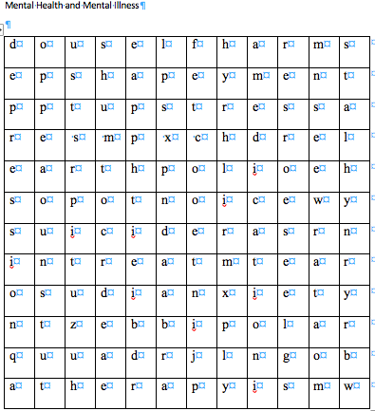
Mental Health and Mental Illness
Can you find ten words in the word search connected to mental health and illness?
Once you have found them you can complete Activity 1

Slide 4
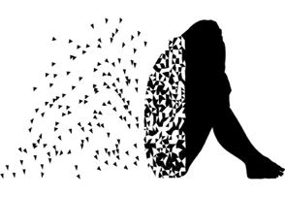
Find words in the word search to help you complete the sentences below.
1. My friend gets lots of____________ from her friends and family as she suffers from mental health problems. She has also decided to get_________ from a professional.
2. Sometimes doctors prescribe__________________ to help you feel better if you suffer from _________________ or have _________ disorder.
3. Some people hurt themselves when they are not happy. This is known as ________________. They may cut themselves.
4. Sadly some people don’t feel they can carry on living and choose to end their life by attempting or committing_______________.
5.It is common to feel ______ from time to time. Not everyone feels happy and upbeat all the time.
6. You can feel a bit____ after recovering from an illness such as the flu.
7. Life isn’t always easy, and many young people have a lot of_________ and pressure in their lives.
8. Some young people suffer from ________and really worry that something bad is going to happen.

Slide 5
Common Collocations
to be in therapy / receive therapy for
to be on medication
to suffer from mental health
to attempt/ commit suicide

Slide 6
Mental health problems affect about 84 million people across EU countries. (2018)

Slide 7
Mental Health Statistics
1._________ of all mental illnesses start before or during adolescence.
Guessing
I’d say that... I guess... My guess is... | It’s difficult to say but I reckon... At a guess I think that

Slide 8
Mental Health Statistics
1. Half of all mental illnesses start before or during adolescence.
2. 29% of 15-year-old girls and 13 % of 15-year-old boys in Europe reported feeling low or down on a weekly basis.
3. One in six 16-24-year-olds has a common mental disorder such as depression or anxiety.
4. Nearly 50% of 17-19-year-olds with a mental disorder have self-harmed or attempted to commit suicide.

Slide 9
Choose a mental illness to research.
You are going to produce a fact file to share with your class.
Include the following information: the name of the illness, general facts and symptoms, treatment and help available.

Slide 10
Reflection

