Slide 1
Communication
Asking and answering politely 1 –
in the restaurant

Slide 2
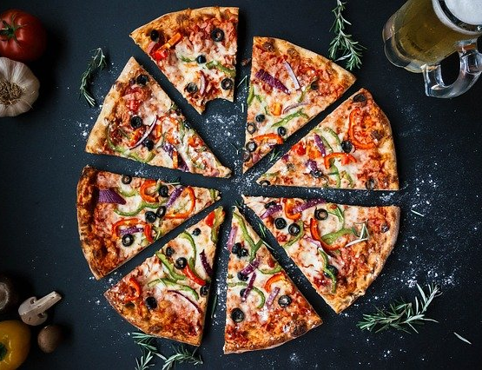
ASKING and ANSWERING POLITELY
Lesson outcomes
By the end of the lesson you will have:
talked about different food in different countries.
discovered and practised ways of asking and answering politely at the dining table.

Slide 3
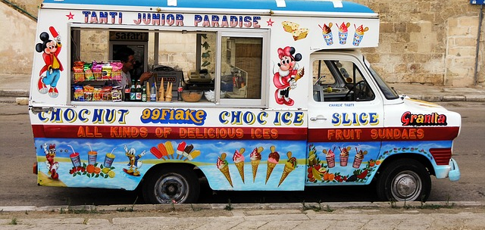
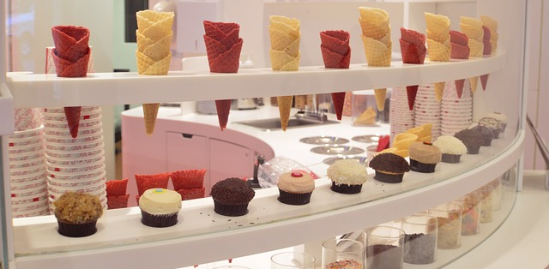
Vocabulary 1: Q. What can we get in the icecream parlour or from the ice cream man?
A. creamy ice cream fruit ice cream ice cream cones
ice cream cornets
scoops of ice cream
tubs
ice cream desserts Now you continue ……….

Slide 4
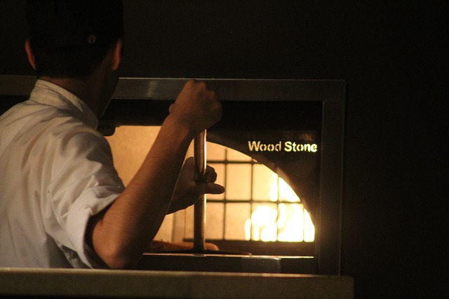
What sort of food do you think you can get in each of these restaurants?

Slide 5
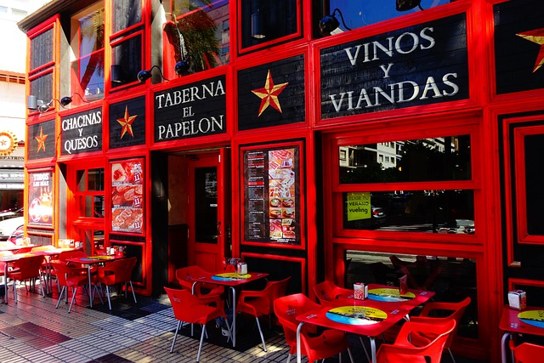
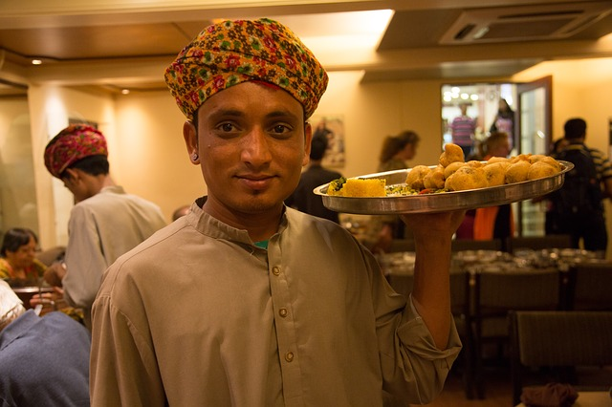
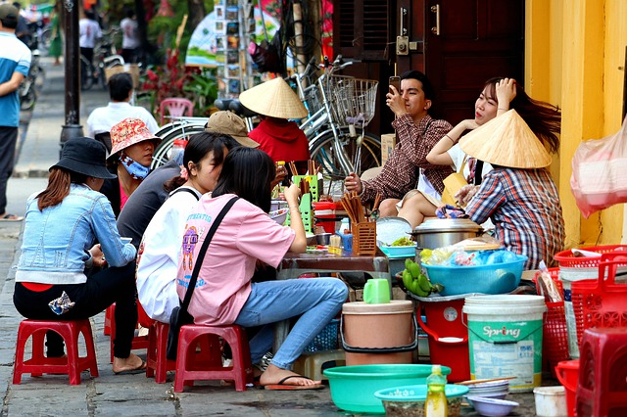
What sort of food do you think you can get in each of these restaurants?

Slide 6
Ways of asking politely:
Ways of asking politely and agreeing:
Can I ….? Yes of course!
Could I ….? That’s fine!
Could I possibly …? Certainly!
Do you think I could …?
Yes of course!
Do you mind/would you mind if I …? No not at all!
Asking other people politely to do things:
Could you (possibly)…?
Do you think you could …?
Will you ..? would you ..?
Nb. Would you mind/ do you mind …? (Of course not!)

Slide 7
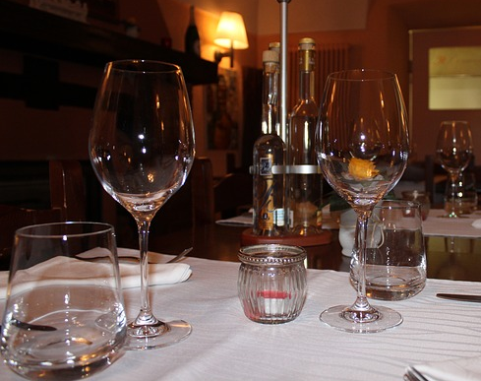
Reflection:
How do you feel about using these expressions?
Do you feel embarrassed using them? Why?
Do you think this language is unnecessary?
If so, why might we consider it important?
Do you have equivalent polite forms in another language you know?

