Slide 1
Problem-solving
Setting up
a community centre/youth club

Slide 2
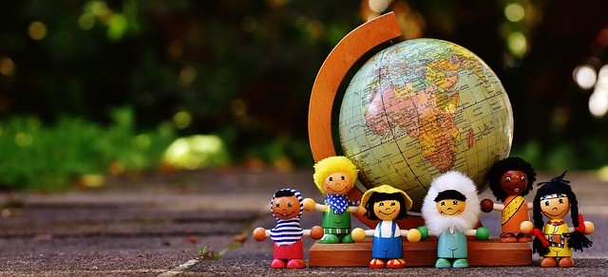
Lesson Outcomes:
By the end of the lesson you will have:
read one person’s experience of working with a youth club and community centre.
understood how to set up a community area for adults and children.
discussed ideas for organising something similar.

Slide 3
Help with Giorgio’s description …
Board Games: e.g. scrabble, monopoly, chess, cluedo.
Do you play any of these games? Can you describe them briefly? Look up Boardgames on Wikipedia.
The kora is an African stringed instrument. Can you find an example of someone playing it? Look up kora on Wikipedia.
Nb.
Choir is pronounced /'kwaɪə /)

Slide 4
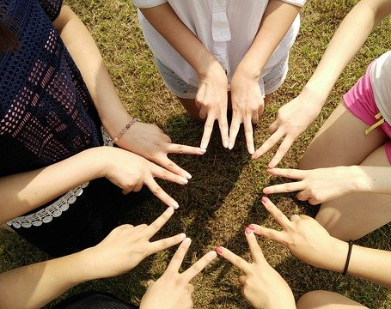
Setting up a Community Centre or Youth Club …
Think about:
who can help you,
where you can go for advice,
the kind of place you should look for,
who you could share with and collaborate with,
where you can get creative materials and games.
Brainstorm ideas for cheap activities for both young and old.

Slide 5
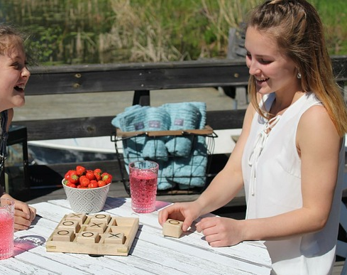
Reflection:
Do you think this idea could work?
Would you prefer a youth club (for young people) or community centre (for everyone)?
How useful can it be in helping integration?
What do you think is the first step to start it up?

