Slide 1
Communication
Social Media

Slide 2
Learning Outcomes
By the end of the lesson, you will have:
reflected on how people communicate
discussed what they think of social media
researched and shared information about useful social media sites, apps or forums

Slide 3
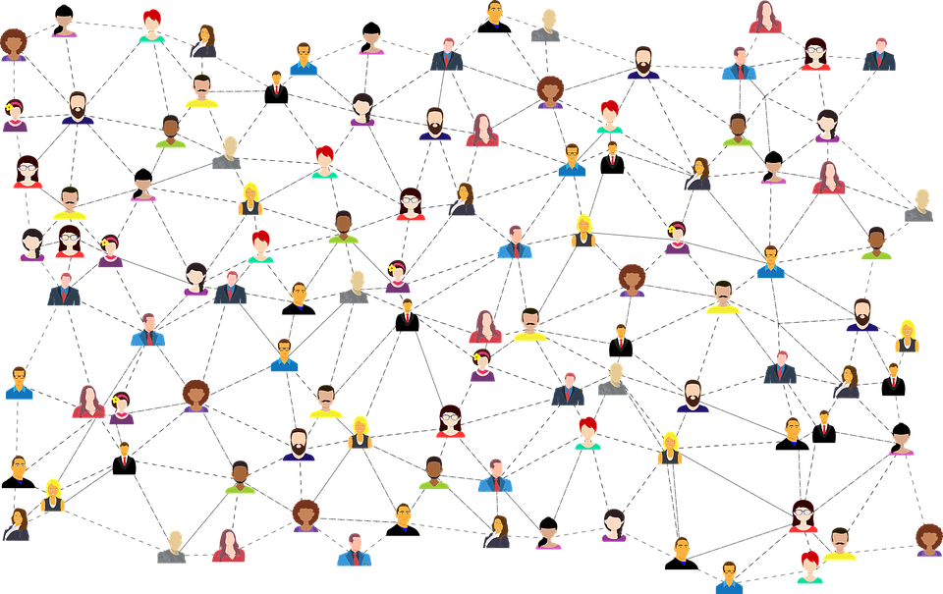
How many different ways of communicating can you think of in one minute?
Have you used these in the past or do you use them now ?

Slide 4
Social Media
Which statements reflect what you think?
The way I communicate here now is so different from the way I used to communicate back home in my country. Everyone here is obsessed with social media. Khadiza, Bangladesh
The way I communicate has hardly changed since I arrived in this country. I rely mostly on social media just like I did back home. Ion, Albania
I’ve found communicating here really challenging. People are just so different and I’m not sure how to use social media very well to say what I want to say. Tirhas, Eritrea
The way people communicate here and the way we communicate back home is almost the same, so I’ve had no problems really apart from the language. Whenever I write anything online or in a text message, I know it’s full of language mistakes. Adam, Sudan
I just can’t communicate with people here. Nobody understands me and I don’t understand them. I sure they think I’m very rude especially when I write things online. Mojgan, Iran

Slide 5
Talking about habits
People tend to…
People have a habit of + verb ING
People are always + verb ING
People can’t seem to stop + verb ING

Slide 6
Do you…
Strongly disagree Disagree Neither agree nor disagree Agree Strongly agree
… Why?
Social media is a great way of connecting with people from different backgrounds and learning about and accepting other people’s views.
Social media is the best way for people new to a country to share their experiences with each other and offer each other advice and support.
Online bullying makes social media a very unsafe way of communicating with others.
It’s impossible to know what is true or what are lies on many social media platforms so it’s best to avoid them when trying to connect with others.

Slide 7
Useful social media sites
Do some research into a social media platform, app, site of group that people who are new to a country might find useful to integrate themselves.
Make a simple fact file about the platform that you have chosen.
Name: Link/ address:
About:

Slide 8
Reflection
Do you think the way you communicate should change because you live in a different country? Why? Why not?
How useful do you think social media is for people new to a country?
Which sites, if any, would you recommend? Why?

