Slide 1
Communication
Values and Beliefs

Slide 2
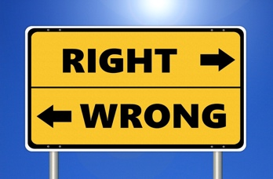
Learning Outcomes
By the end of the lesson, you will have:
shared and discussed their personal values and beliefs
watched a short YouTube clip on values
produced written responses to questions on values and beliefs
considered how values and beliefs can help them be a part of the society they live in

Slide 3
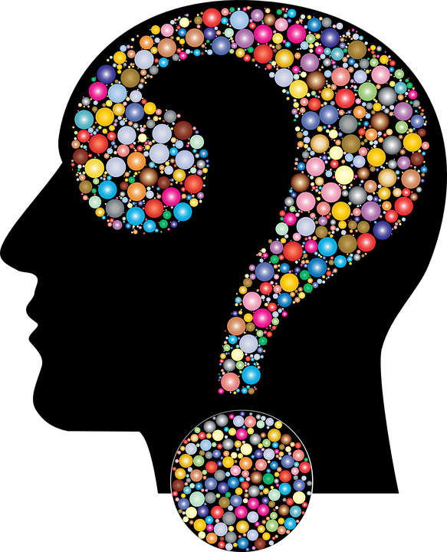
What matters to me.
What is important to you?
Choose three things that are you important to you in your life.
Why did you choose those things?
Did you find it difficult to choose only three things?
Saying something was difficult
This wasn’t the easiest thing to do but…
I found it ever so tricky to…
It was really tough choosing only three things but, in the end, I went for…
To be honest I really struggled to think of…
I struggled a bit with this but my final top three are…

Slide 4
What matters most in life?
Watch the clip and decide if the statements are True (T), False (F) or Not Given (NG)
Money is definitely something that makes people happy in life.
Whilst love is good for you, it’s not as important as happiness.
People who are generally unhappy find it difficult to love others.
How someone feels is equally as important as their personal values.
Values can stop you from following your feelings.
There can be a lot of tension between how you feel and your values.
An animal’s life is just as precious as a human’s life.
A person who has high moral values is less likely to cheat.
Criminals have no values whatsoever.
Only law-abiding citizens struggle with their feelings and values on a daily basis.

Slide 5
What do you think?
Write answers for the following questions about beliefs and values.
Look at the list of common core values below. Do you think these values are as important to people where you live now compared to where you lived before?
Faith Family Freedom Friendship Health Happiness
Honesty Respect Tradition Trust Wealth
How important do you think it is to understand the values and beliefs of the people in the country where you live now? Why do you think this?
How realistic do you think it is for people with different values and beliefs to live together?

Slide 6
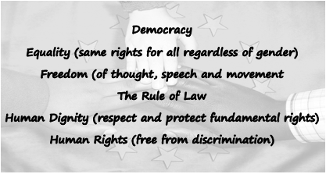
Reflection
What is your understanding of EU values?
Find out more at…
EU Values

