Slide 1
Problem-solving
Organising a
football tournament

Slide 2
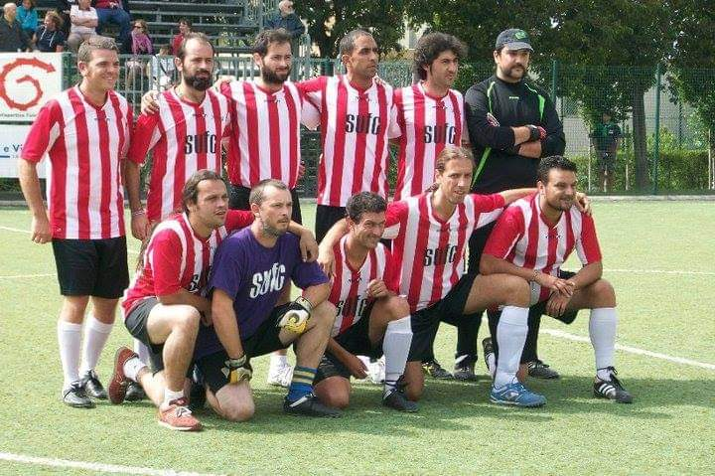
Lesson outcomes
By the end of the lesson you will have:
understood how to organise successfully a sports tournament.
listened to the tournament organiser.
taken notes and used them to draw a plan.
explained the organisation to each other.

Slide 3
Listen to Mick!

Slide 4
Vocabulary: special phrases to know:
Choose the correct definition in each case:
A 5-a-side football tournament a) If the score is 2-1 the winner scores 2 the loser scores 1.
It takes quite a long time. b) The 2 teams play together, one against the other.
The winner and the loser c) There are only 5 players in each team, not 11.
The 2 teams played each other d) When the game finishes in a draw, each team takes
alternate shots at the goal to decide the winner.
5. To take penalties e) The time needed (to organise) is considerable.

Slide 5
Mick’s Tournament Organisation (use to check)
loser winner
red
orange v red
orange
orange v yellow red
green v green
green
orange blue
v blue v pink
pink
v
blue white white
maroon v white
maroon
red
O#ange

Slide 6
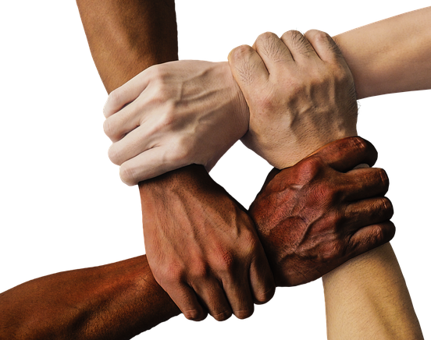
Reflection
Discuss all together:
Is sport an effective way to encourage friendship and integration?
Why? Why not?
What other suggestions do you have to encourage friendship and integration?

