Slide 1
Communication
Listening 1 – Active Listening

Slide 2
Lesson Objectives
By the end of the lesson you will have:
considered what active listening is and why it is important
learned how to make suggestions to help others improve their active listening skills
practised active listening

Slide 3
Good or bad listeners?
Think of an example of one person who you feel listened to you in your life and an example of one person you feel did not. Who were they? What did you talk to them about?
Tell your partner about your experiences with these two people.

Slide 4
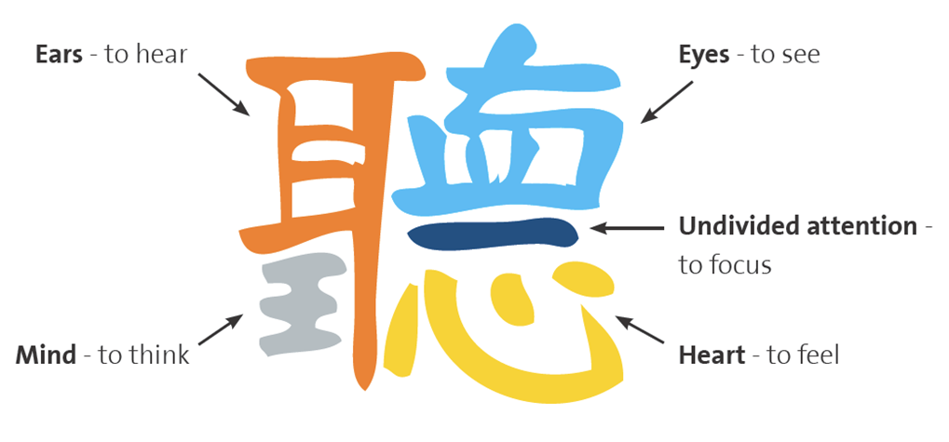

Slide 5
Are these good or bad listening habits?
pay close attention to everything the speaker is saying
make eye contact throughout the conversation
only focus on what the speaker is saying and nothing else about them e.g. body language
put your thoughts on hold
interrupt to check information
plan how you are going to respond at the same time as listening
start to talk about your own experiences
show that you are listening by smiling, nodding or saying ‘Yes’
repeat back to the person what they said to you to check that you have understood correctly
ask a lot of questions
decide on your own opinions before the speaker has finished speaking
think about something else at the same time as listening
finish the speaker’s sentences for them

Slide 6
Good listening
Do’s | Don’ts

Slide 8
Over to you. Choose one of the following to talk about.
What you did last weekend
Your hobbies
Your best friend
Your family
A journey you have taken

Slide 9
Reflection
How similar or different is the way people speak here compared to your own country?
What difficulties do you have listening to people or do you feel you listen well to other people?
Which aspects of active listening do you think you could work on and improve?

