Slide 1
Health and Well-being -
Project: Recipe Collection

Slide 2
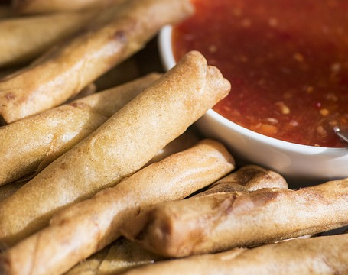
Lesson Outcomes:
By the end of this lesson you will have:
talked about your favourite dishes from where you come from.
learned about your companions’ favourite dishes.
worked together in groups to decide the recipes that best represent your countries.
written out at least one recipe, ingredients and method, for a minimum of one dish each, that you know very well.
shared this information with the rest of the group.

Slide 3
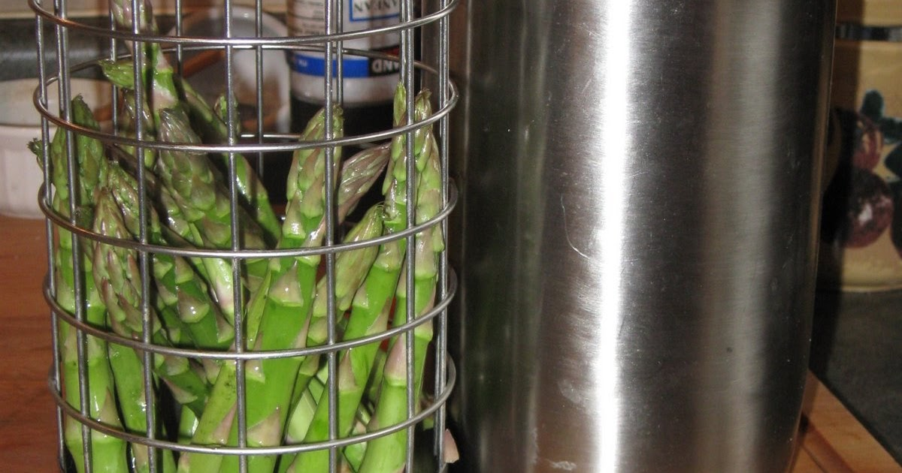
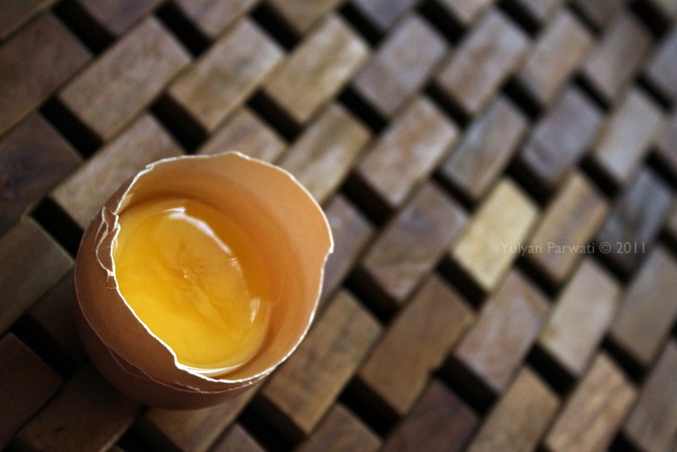
What is your favourite food at home?
What are the most popular dishes eaten in your family’s country?
Which recipe or recipes would you like to share with all of us?
This Photo by Unknown Author is licensed under CC BY-NC-ND
This Photo by Unknown Author is licensed under CC BY-NC-ND

Slide 4
Look at these examples of recipes:
We have the list of ingredients.
The quantity goes before the ingredient.
The method is short and concise language telling us what to do. Use the imperative form.
For example:
Peel (the apple)
Chop (the onion)
Add (salt and pepper)
Stir (the sauce)
Check the meanings and spellings of verbs before you use them.
Check that the verbs you have chosen are usually used in recipe methods and remember that COOK is very generic ……

Slide 5
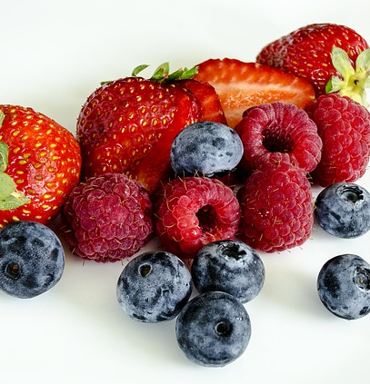
Summer Pudding
300 gms strawberries
250 gms blueberries
100 gms redcurrants
500 gms raspberries
175 gms brown sugar or white sugar
7 slices of bread
Method
Dissolve the sugar in a little water on a low heat.
Add the soft fruit (but not the strawberries) and heat gently for 2-3 minutes.
Wet the bread in the fruit juice.
Cover the sides and bottom of a ceramic bowl with the sliced bread.
Fill the centre of the bowl with the fruit and cover the top with bread slices.
Put a small plate on top of the bowl, and something heavy like a
packet of flour or sugar.
Cool overnight and serve turned out upside down, with fresh
whipped cream.

Slide 6
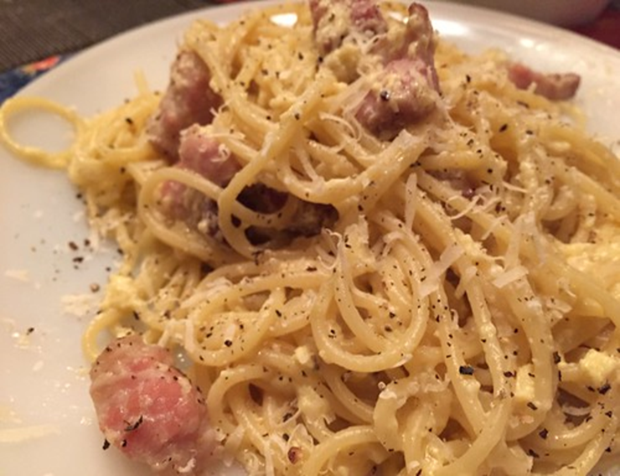
Spaghetti alla Carbonara source: alberghiera.it

Slide 7
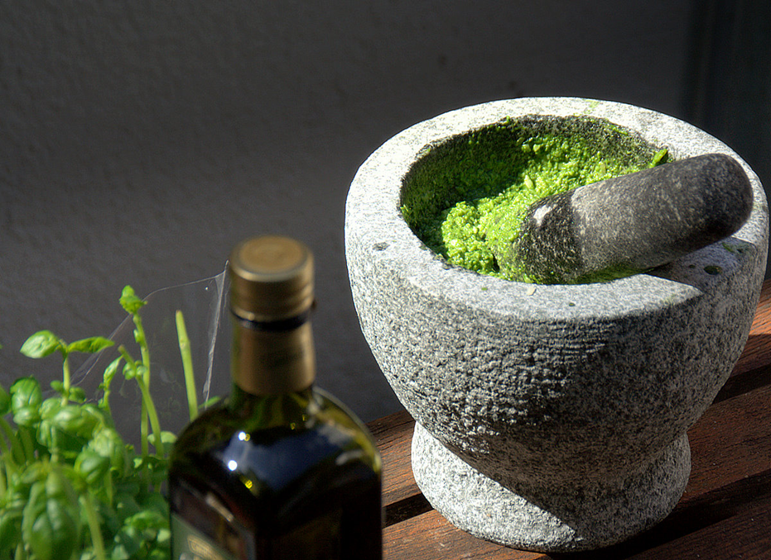
Pasta with Pesto Genovese source: alberghiera.it
Pesto Genovese Ingredients fresh basil leaves a clove of garlic grated Pecorino or Parmesan cheese pine nuts extra virgin olive oil rock salt Method Clean the basil leaves. Peel the garlic. Put the basil, garlic, pine nuts, rock salt and a spoon of oil in a mortar. Crush together with a pestle until the mixture becomes creamy. Add grated cheese. Stir together Serve the sauce on freshly cooked pasta. Alternatively, to save time, the basil, pine nuts, garlic, salt and oil can be mixed together in a blender.

Slide 8
Let’s make a recipe collection!
Work in groups to create a recipe leaflet, including a video, of simple recipes you
often ate with pleasure at home, in a restaurant or street food stall.
Remember they should be dishes typical of the area you come from.
Look at your teacher’s examples and the language box, to understand the
language of recipe methods.
Prepare to present one of them to the other groups.
Always ask your teacher if you have any doubts!!

