Slide 1
Communication
Asking and answering politely 2 – Everyday situations

Slide 2
ASKING and ANSWERING POLITELY
Lesson outcomes
By the end of the lesson you will have:
Talked together about everyday situations.
Discovered and practised ways of asking and answering politely, formally or informally, in situations important to your everyday life.

Slide 3
Every day …. Listen …..
This Photo by Unknown Author is licensed under CC BY-NC

Slide 4
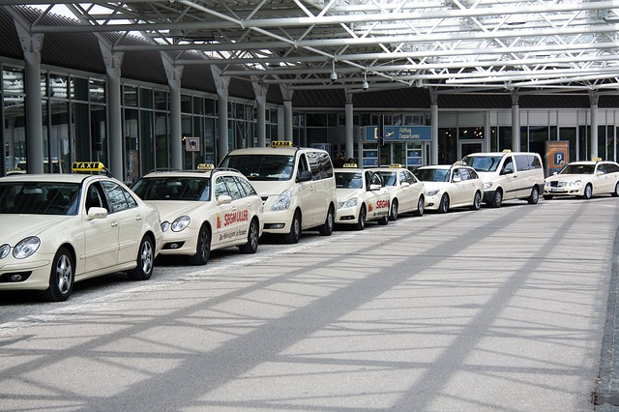
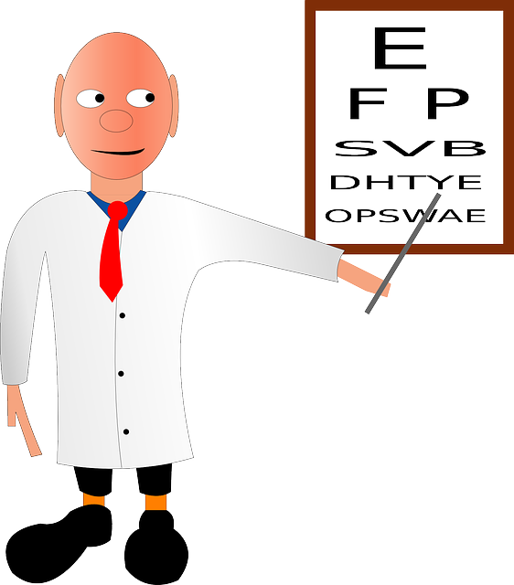
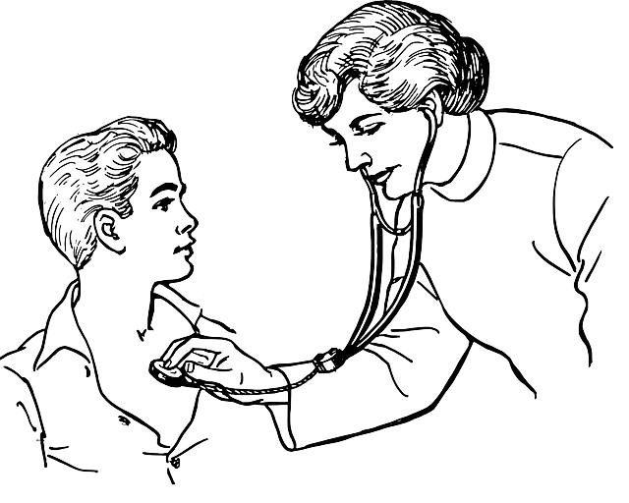
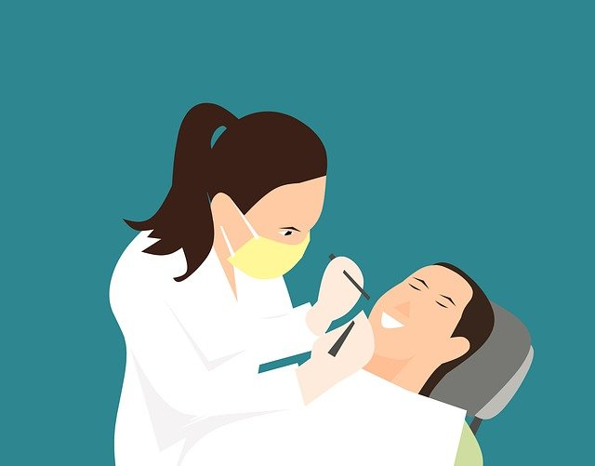
Asking and answering politely in everyday situations

Slide 5
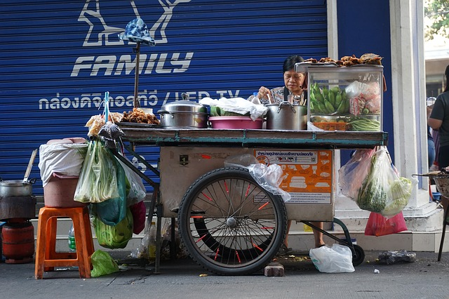
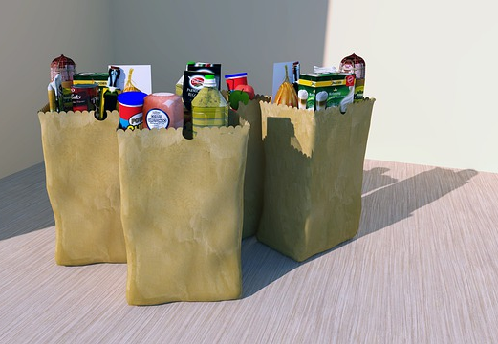
Asking and answering politely in everyday situations

Slide 6
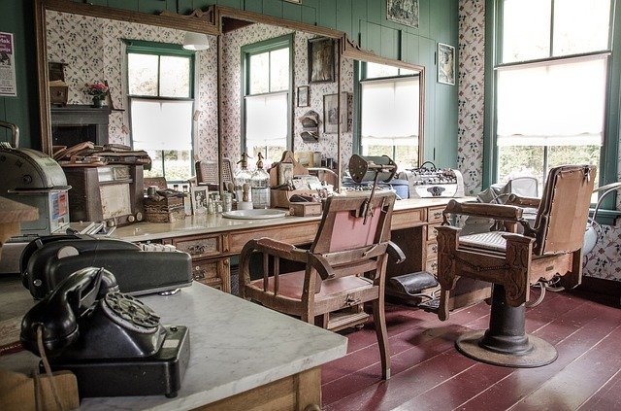
asking and answering politely in everyday situations

Slide 7
Reflection:
How do you feel about using formal and informal expressions?
Do you feel embarrassed using formal language? Why?
Is it easier to use informal language? Why?
Do you consider formality unimportant? If so, when might we consider it important?
Do you have formal language in your language? Is it used in the same way as English?

