Slide 1
Work
Workers’ Rights

Slide 2
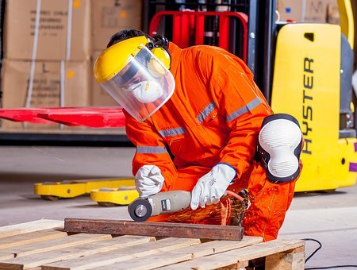
Lesson Objectives
By the end of the lesson, you will have:
discussed some of the rights and responsibilities of employers and employees
read some work-related scenarios in order to consider the rights and responsibilities of the employers and employees
role played work situations asking for and responding to requests for permission

Slide 3
Rights and responsibilities
Employer or employee?
‘come to work on time’
‘provide appropriate protective clothing for the job’
Rights or responsibilities?
Rights
things you are morally and legally entitled to have and expect in a job e.g. be given a contract of employment
Responsibilities
duties you have to do because of your job or position e.g. wear appropriate protective clothing

Slide 4
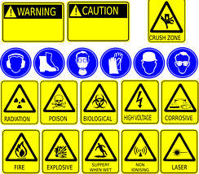
Rights and responsibilities
Work in a small group to complete the table. Use some of the words in the glossary. Think about:
training protective clothing / equipment leave (holiday / parental)
adequate breaks during work hours holiday / sick pay health and safety
facilities (e.g. rest area) treatment/equality of workers

Slide 5
The right thing to do
Eduardo works in a small shoe shop. He is entitled to one hour-long break every shift. He’s often the only person working with the shop manager. Sometimes, the shop gets very busy and Eduardo can’t take his hour-long break. On those occasions, the manager simply says “Sorry, it’s too busy for you to have a break today.” Eduardo thinks he should be paid for working the extra hour but he isn’t. What should Eduardo do?
Alexis has been working in a factory for over a year. One day her supervisor asks her to complete a dangerous task that is not part of her job description. She doesn’t want to do it but is worried that if she refuses her supervisor might decide to fire her. What should Alexis do?
Severine is training to be a chef. She spends half her time at college and the rest of the time doing placements in restaurants. She is about to do her first placement and has been told she has to buy special clothes and equipment for the placement. She can’t afford to do this but the restaurant says she can’t work there without the items. What should Severine do?

Slide 6
The right thing to do
Bhavana works for an IT company. She has just heard that her father has had a stroke and she wants to visit him in hospital. Her parents live in India. She gets 28 days paid leave each year. She has already used 24 days but will need more than 4 days to visit and doesn’t know how long she might need to stay. What should Bhavana’s employer do?
Masoud and his wife have recently had a baby. She is thinking about going back to work and wants to work during the day whilst Masoud stays at home to look after the baby. He currently works during the day in a supermarket but wants to change his working pattern and start working night shifts. What should Masoud’s employer do?
Davide is an accountant in an office. He spends long hours working on a computer. He has recently started getting terrible headaches. He had his eyes tested and got some new glasses but is still getting the headaches. What should Davide’s employer do?

Slide 7
Roleplay
Work with a new partner to role play some of the situations. Take it in turns to be the employer and employee. Use the language in the language box.
Language Box: Asking for and responding to requests for permission
Asking for permission I was wondering whether it would be possible to + bare inf. Is there any possibility that I could + bare inf. Would it be alright if I + bare inf. I think I am entitled to + noun | Responding to requests for permission Have you thought of … + ing That’s find but you’ll have to … (take it as a day’s unpaid leave / let XXX know that …) I’m sorry but that’s not possible because …

Slide 8
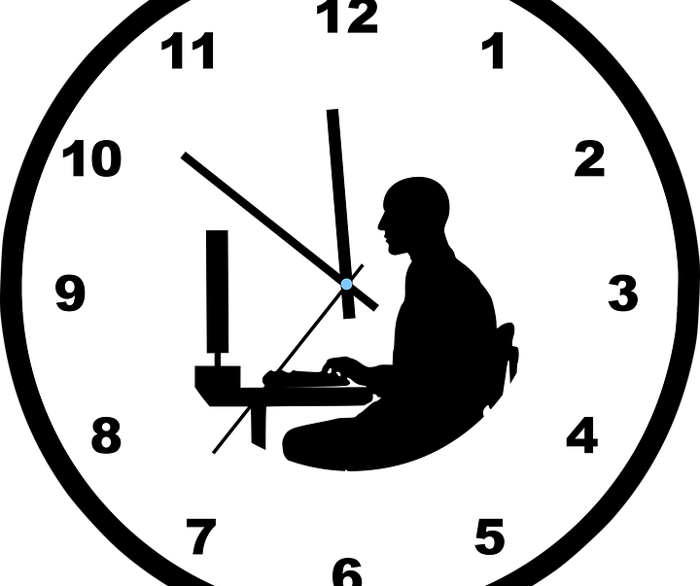
Reflection
How much do you know about the rights workers have in the place where you live now?
What is the minimum wage? What is the average paid holiday employees can expect? How long do new parents get after the birth of a new baby?
Why is it important to know about employer’s and employee’s rights and responsibilities?
Why do you think rights and responsibilities are different in different places around the World?

