Slide 1
Health and Wellbeing
Talking about Feelings

Slide 2
Learning Outcomes
By the end of the lesson, you will have:
shared your views on physical and mental health
looked at different adjectives to describe negative feelings
read and discussed four different people’s problems

Slide 3
A healthy person
Draw a simple drawing of a healthy person.

Slide 4
Physical Health vs. Mental Health
I keep/ don’t keep myself physically healthy.
For me being mentally healthy is/ isn’t as important as being physically healthy.
I know/ don’t know how to look after my mental health.
I’m comfortable/ not comfortable talking about how I’m feeling.

Slide 5
I just feel…
1. anxious
c. to feel worried because you think something bad might happen
2. depressed
d. to feel really very sad because of a difficult or unpleasant situation that you feel you can’t change or, to suffer from a medical condition that makes you feel so unhappy you can’t lead a normal life (clinically ...)
3.down
a. to feel sad and gloomy (informal)
4. low
e. to feel unhappy and without energy often after an illness
5. stressed
b. to feel really worried and unable to relax

Slide 6
How might someone feel about ...?
arriving in a new country
not speaking the same language as others
waiting for results
having very little or no money
feeling lonely

Slide 7
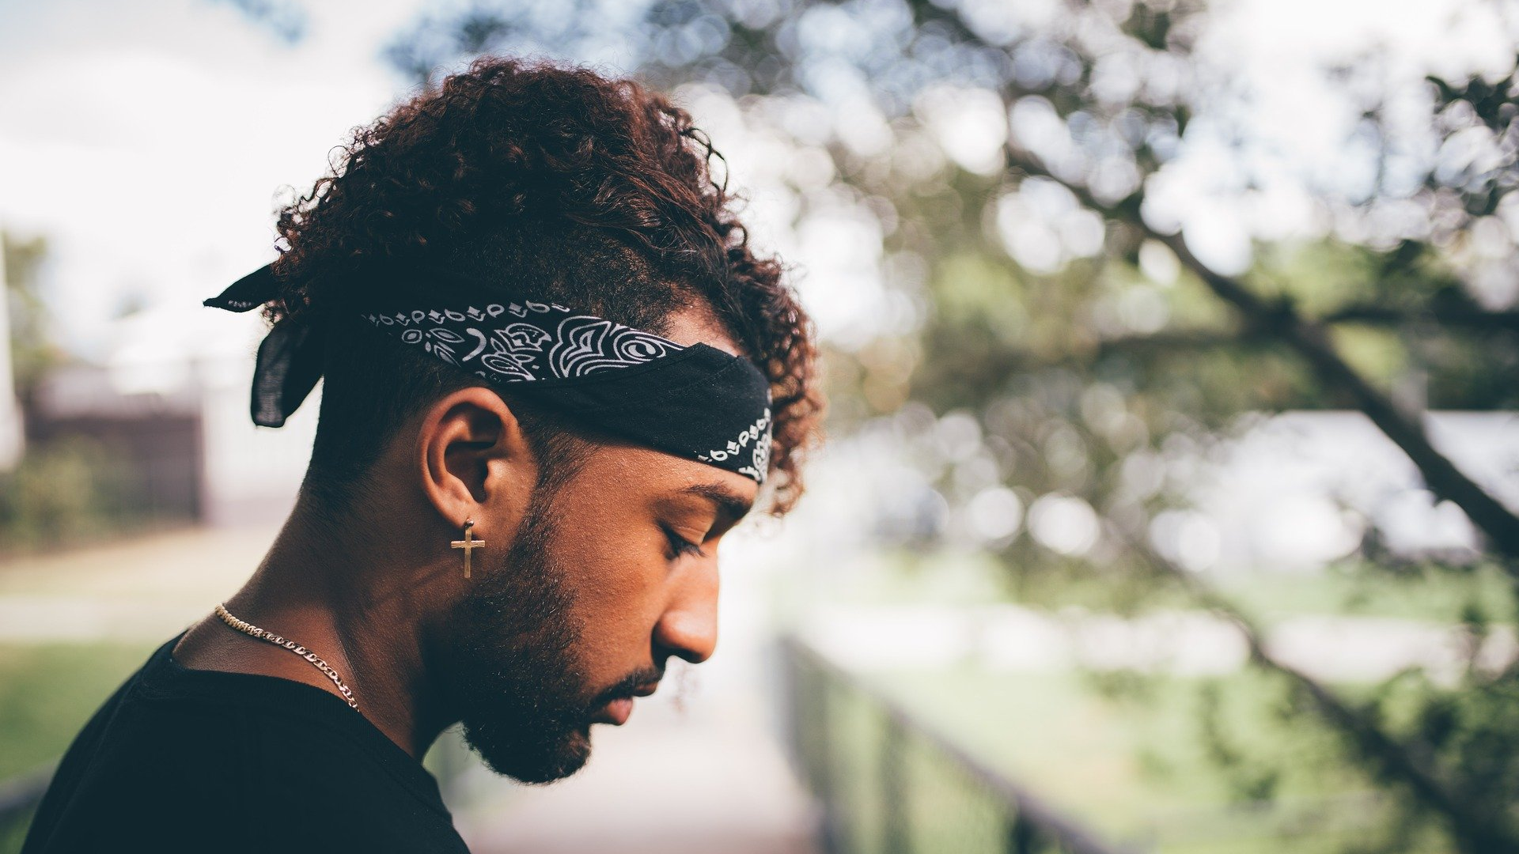
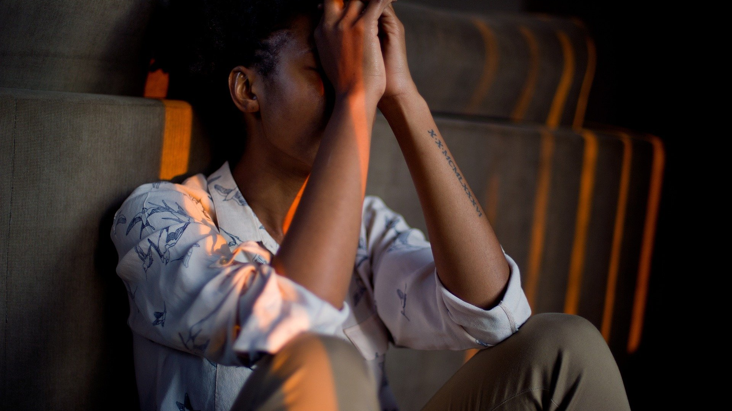
four people - ‘our problems’
Read and discuss how each person feels.
How serious do you think their problem is?
Who do you think would be able to help them?
What advice would you give to them?

Slide 8
Reflection
How important do you think mental health is for people your age?
Do they think being mentally healthy is as important as being physically healthy?
Why? Why not?
How comfortable do you or your friends feel talking about their mental health?
Why do you think this is? What makes it easier or harder? Does a person’s age,
gender or cultural background influence how they find talking
about their mental health?

