Slide 1
Communication:
Classroom Expectations

Slide 2
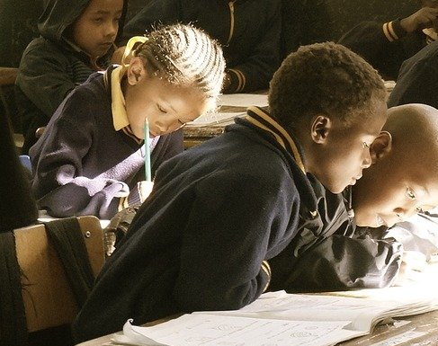
Lesson Outcomes:
By the end of the lesson you will have:
talked about your classroom expectations.
grouped your ideas.
compared and written your ideas.
created a final list of expectations for the school year.

Slide 3
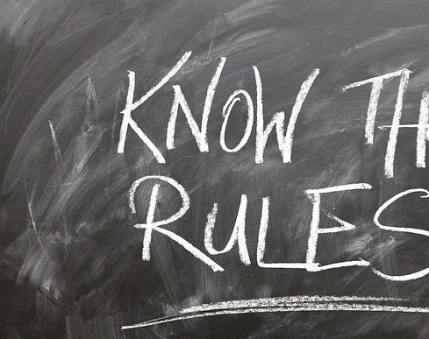
Rules v Expectations
Rules are a list of things we should not do.
Expectations are guidelines developed by students for students and which encourage responsibility.
~ Brainstorm. Together.
~ Group. Together.
~ Reduce and regroup. Together.
~ Display the final list and review them frequently.

Slide 4
Important vocabulary. Read the definitions. Write some example sentences.
Respect (verb) (noun) = to have regard for the feelings, wishes or rights of others.
Eg. We always respect our classmates and think about how they are feeling.
Tolerate (v) = to allow without interference, the practice of something you disagree with or dislike.
Collaborate (v) = to work together on a project or activity.
Listen (v) = listen to each other, listen to the teacher.
Behave (v) = to conduct yourself within the acceptable norms of society
Behaviour (n) = the way you act towards other people.
Be punctual = to arrive on time.
Punctuality (n) = being on time.

Slide 5
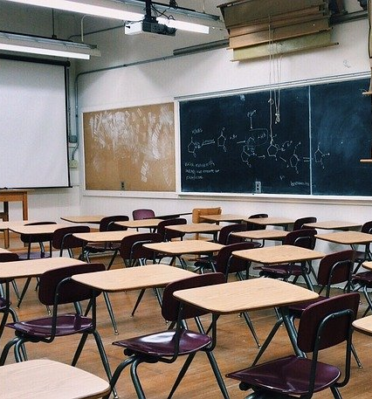
Reflection
Do students agree with this idea of collaborating on classroom expectations?
Does anyone disagree or think another way is “better”? eg. the teacher being more authoritarian or imposing punishment for “bad” behaviour?
What experience do they have from the past?
Invite comments.

