Slide 1
Problem-solving:
Setting up a library and study area

Slide 2
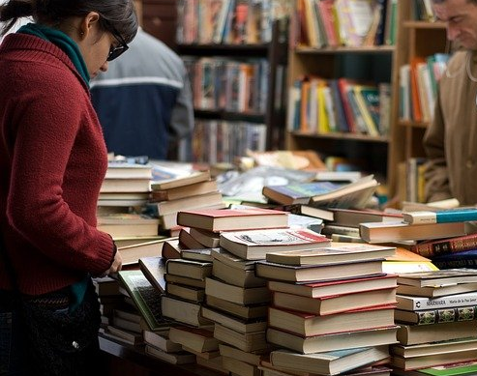
Lesson Outcomes
By the end of the lesson you will have:
read about setting up a public reading and study area for adults and children.
read one person’s experience of setting up a community library.
discussed how to set up and organise something similar.

Slide 3
Reading and Public Libraries
Do you read? What do you read? What language do you usually read in?
Do you ever go to a public library?
What can people do at the library? Eg. Choose books, audio books and Dvd’s to borrow ….
Summarise your suggestions for the teacher.

Slide 4
Vocabulary
To set up (a club) = to create or establish (a club).
To run (the club) = to organise and manage (a club).
To enrol (enrolled) = to join a club, become a member of a club
To retire/To be retired = to finish working because you are old enough to stop.
To open on alternate days = to open one day yes, one day no.
The suburbs of the city = the outskirts of the city, not the centre.
An aisle = a passage between two rows of seats or (in this case) bookshelves.
several = not many, but more than two.
Give some examples!

Slide 5
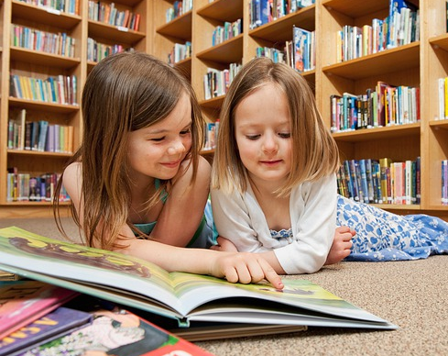
Setting up a library in your community:
Who can help you?
Where can you go for advice?
Who could you share with, if necessary?
Where could you get bookshelves, tables and computers?
Where can you go for books of every kind?
Are there other events you could organise that is not just book-borrowing?

Slide 6
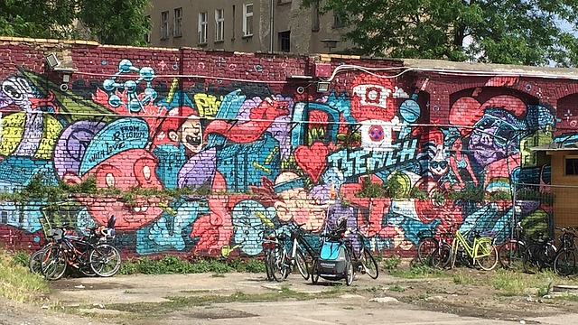
Reflection:
Do you feel enthusiastic about this project?
How useful can a library be in helping integration?
Do you think the idea can work where you are living?
What do you think is the next step to start it up?

