Slide 1
Health and Wellbeing
Eating Trends

Slide 2
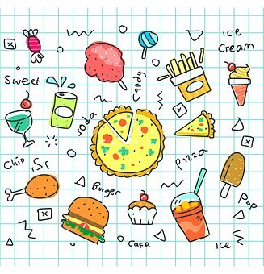
Lesson Objectives
By the end of the lesson, you will have:
found out about and discussed your classmates’ food preferences
listened to people explaining why they are vegetarian or vegan

Slide 3
Put the words in the box in the gaps to finish the sentences.
processed organic fussy on the go vegetarian vegan ready meal
My little brother always eats the same food and won’t try anything new or different. He’s a very __________ eater.
2. When we are feeling lazy, we just heat up a _______________ instead of cooking something.
A _________________ doesn’t eat meat or fish but will eat dairy products such as cheese and milk.
A _____________ will only eat plant-based food.
The farmer who lives close to us only produces ___________ food. He never uses chemicals on the fruit and
vegetables he grows.
____________ food has chemicals to improve the flavour. The food also lasts longer than fresh food because
of the chemicals.
6. I’m really busy and generally don’t have time to stop, sit down and eat. I often just eat _______________ whilst I am working or going somewhere.

Slide 4
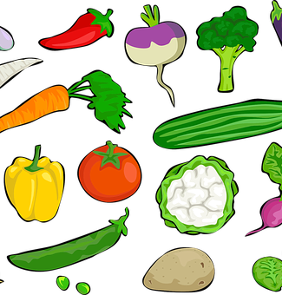
Being vegetarian or vegan
Why do people decide to be vegetarian or vegan?
Listen to the 5 speakers saying why they are vegetarian or vegan. Do they mention any of your ideas?

Slide 5
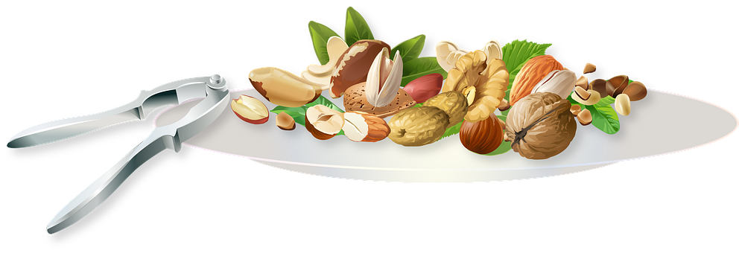
True or False?
1. Speaker 1 thinks her hair and skin have improved since becoming a vegetarian.
2. She thinks it’s easy to be vegetarian because she does most of the cooking at home.
3. Speaker 2 decided to become vegan after reading posts and watching videos on social media.
4. Before he became vegan, he had no idea what to eat.
5. He misses eating meat.
6. Speaker 3 became a vegetarian because a lot of her friends were writing about it on Instagram.
7. She takes vitamins every day because her diet is quite unhealthy.
8. Speaker 4 has been vegetarian for most of his life.
9. Speaker 5 became vegan because she was very unhappy with the way animals are treated to produce food.
10. She feels very tired on a vegan diet so now includes eggs to increase her protein levels.

Slide 6
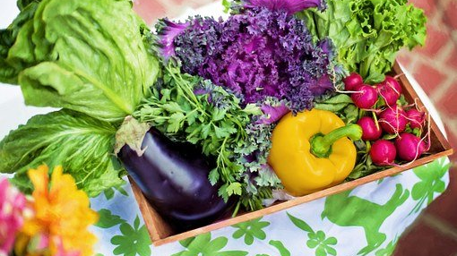
Reflection
Do you know anyone who is vegan or vegetarian? How easy / difficult was it for them to change what they eat?
Have you ever thought of becoming vegan or vegetarian? Why? Why not?
Would it be easy to become vegetarian or vegan in your household? Why?
Are there many vegetarians or vegans in the country where you live now or in other countries you know?
Why do you think, vegetarianism and veganism are popular in some countries and not others?

