Slide 1
Relationships
Family

Slide 2
Lesson Objectives
By the end of the lesson you will have:
looked at words to describe different families
described a family and listened to a description of a family
compared different families

Slide 3
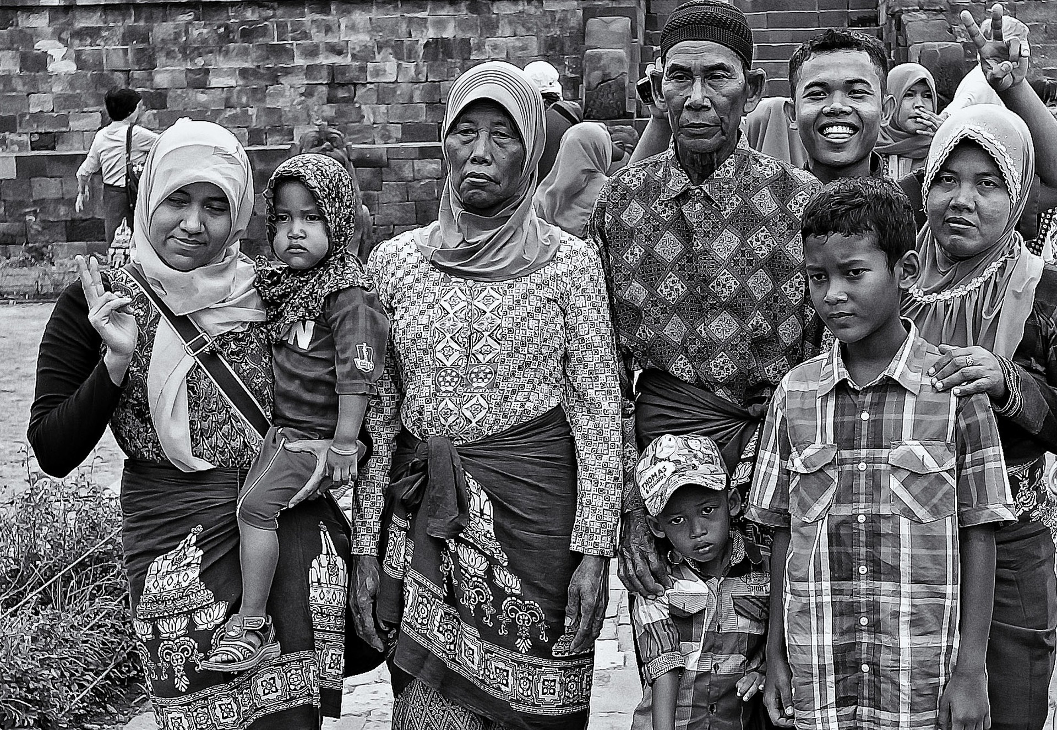
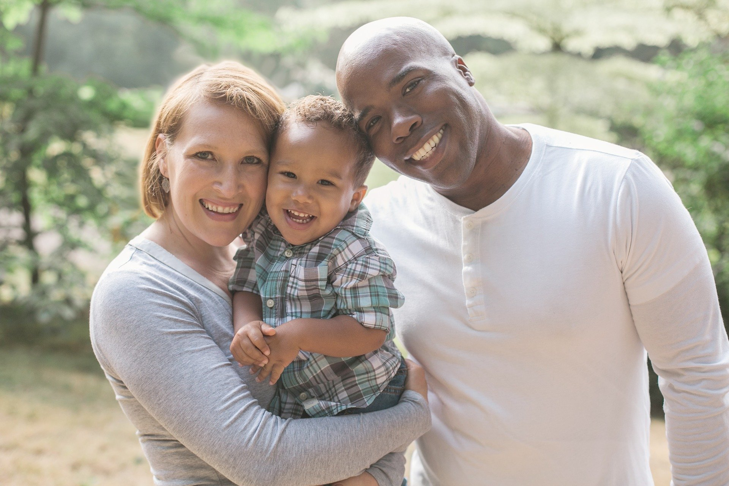
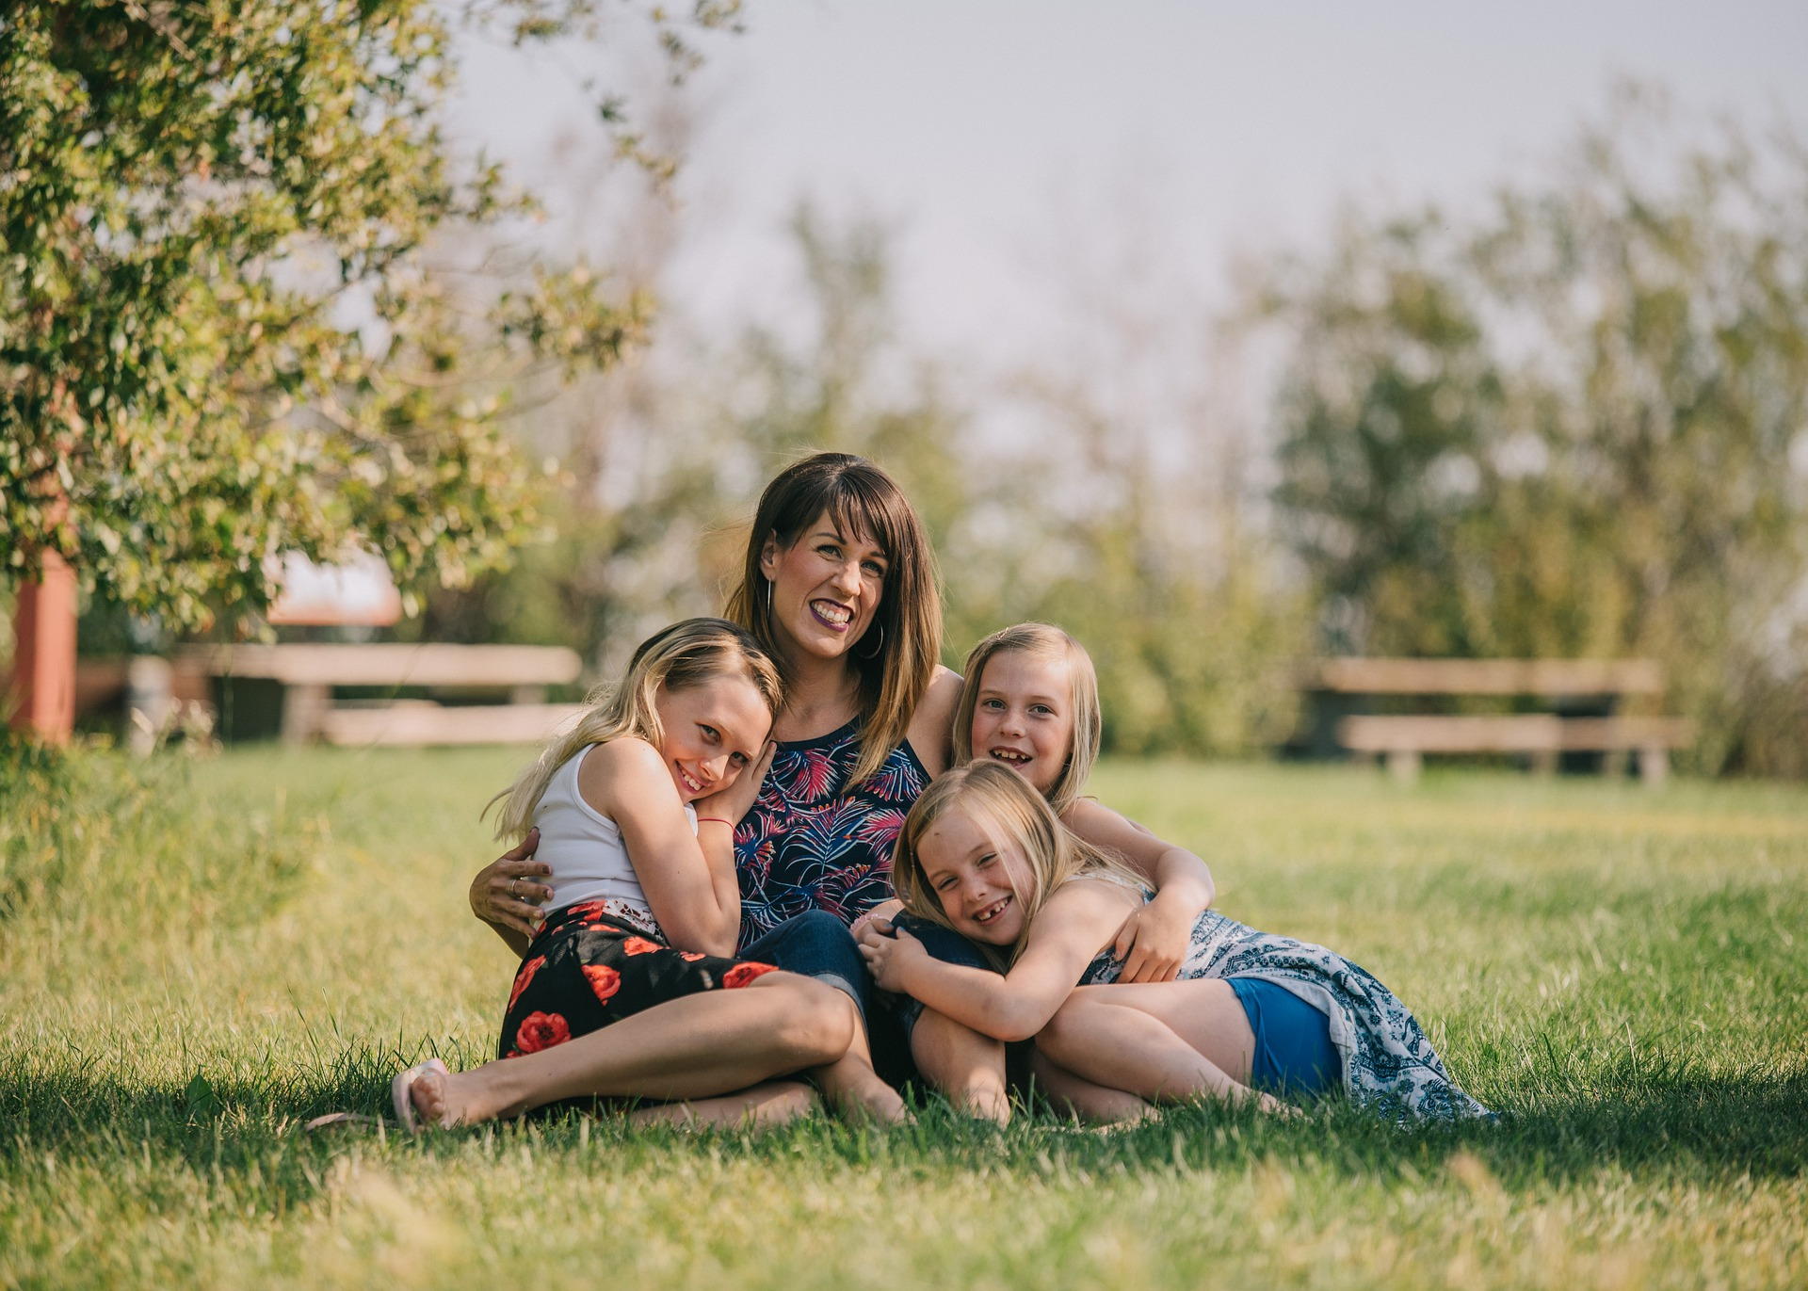
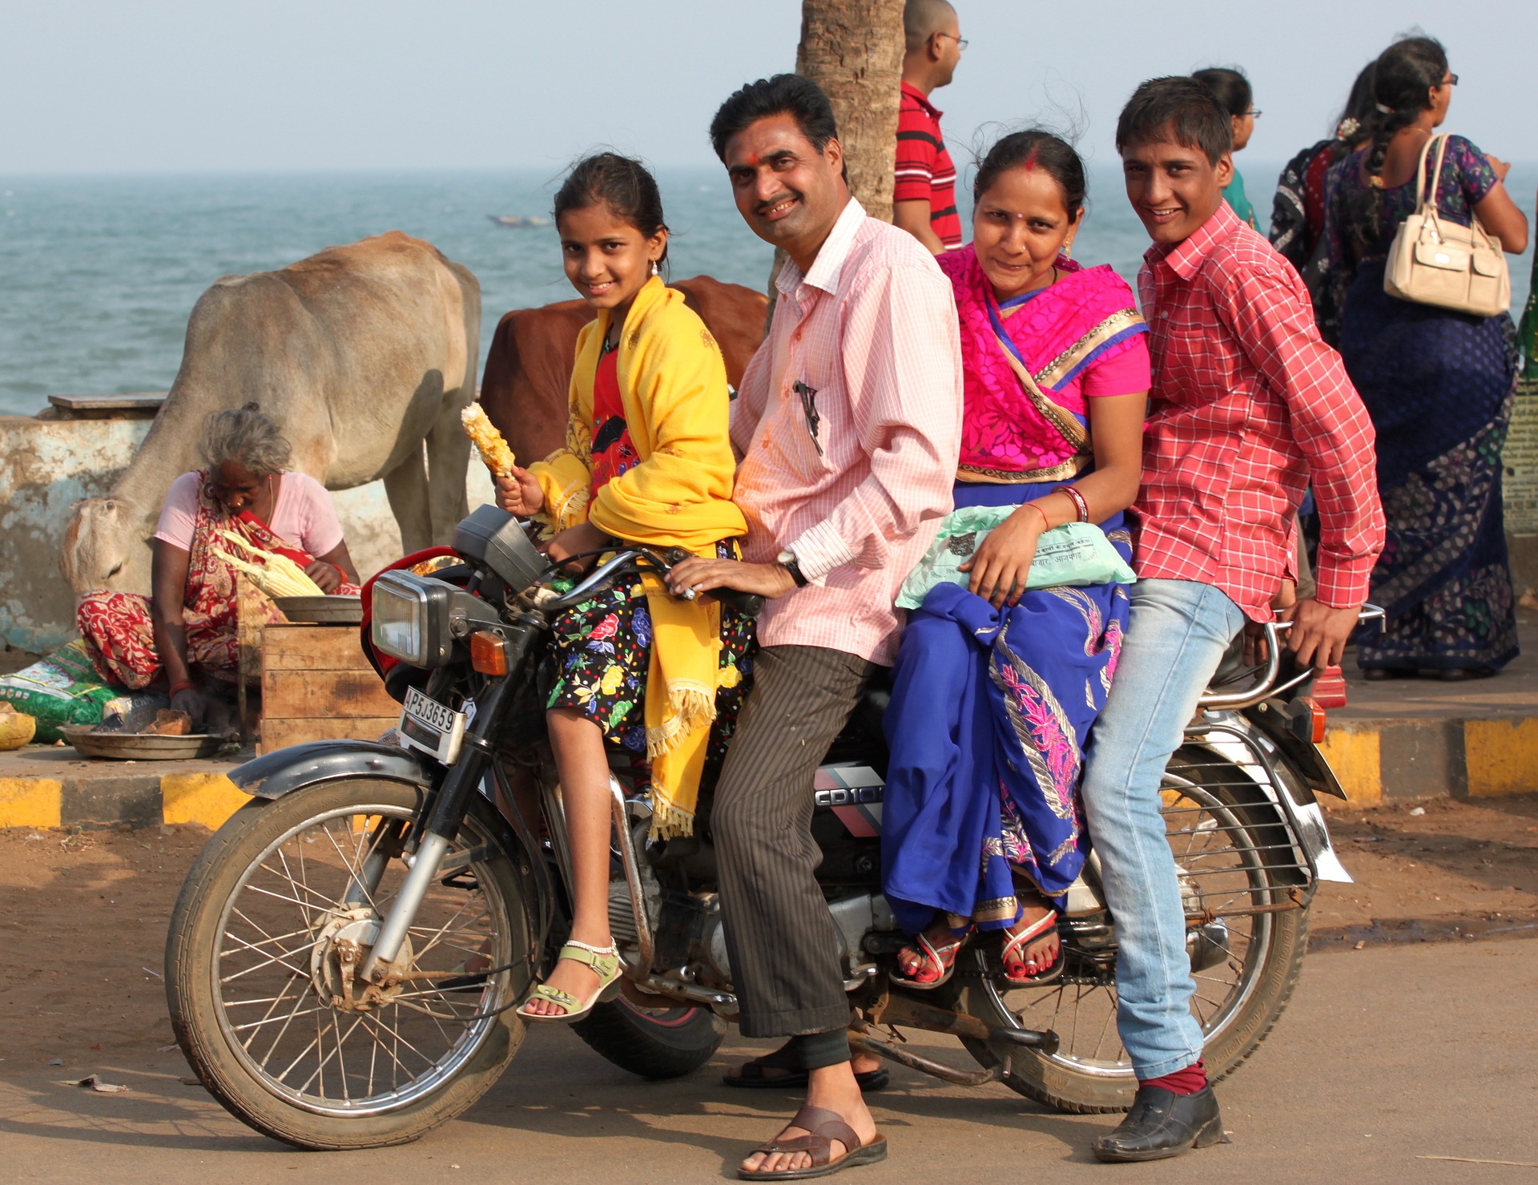
Family

Slide 4
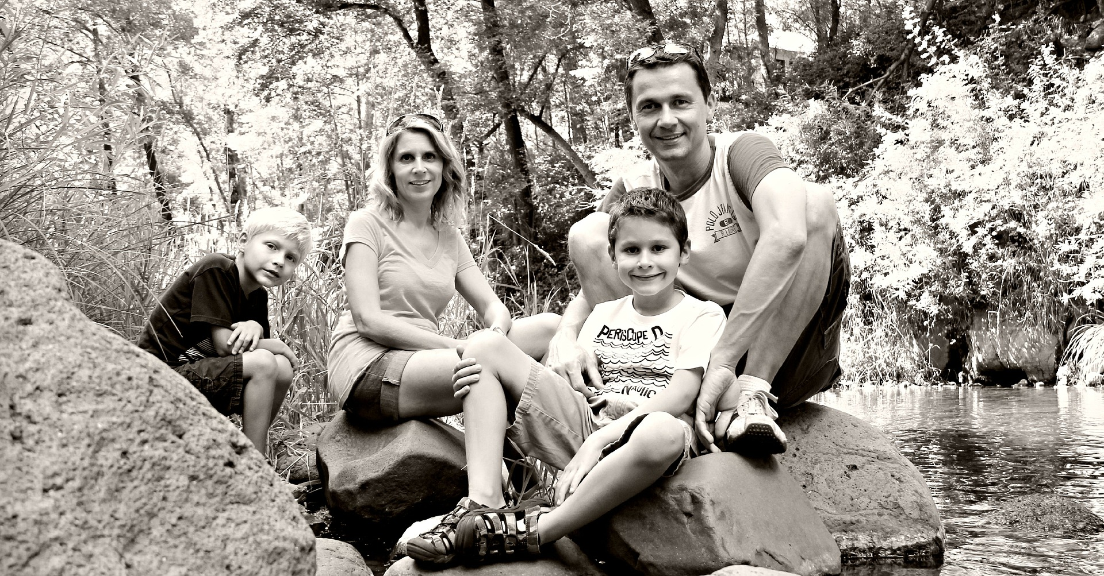
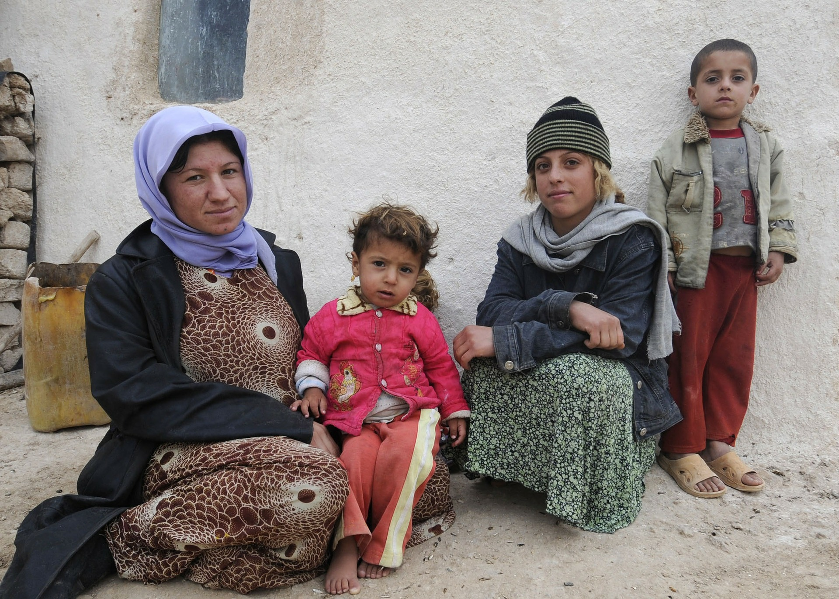
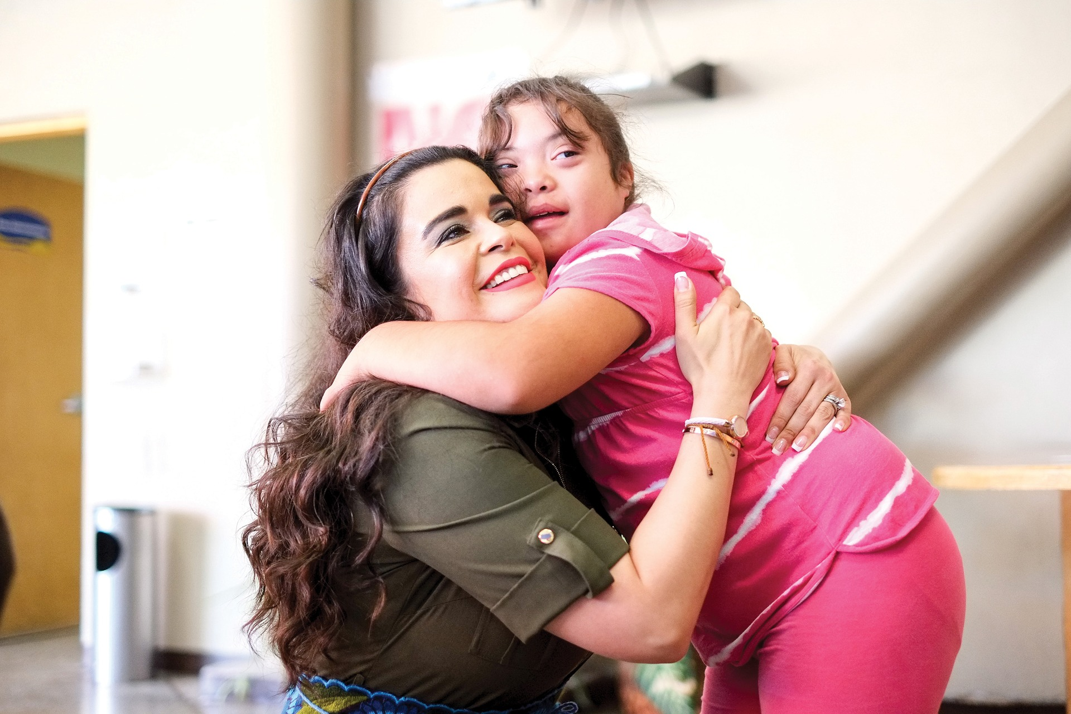
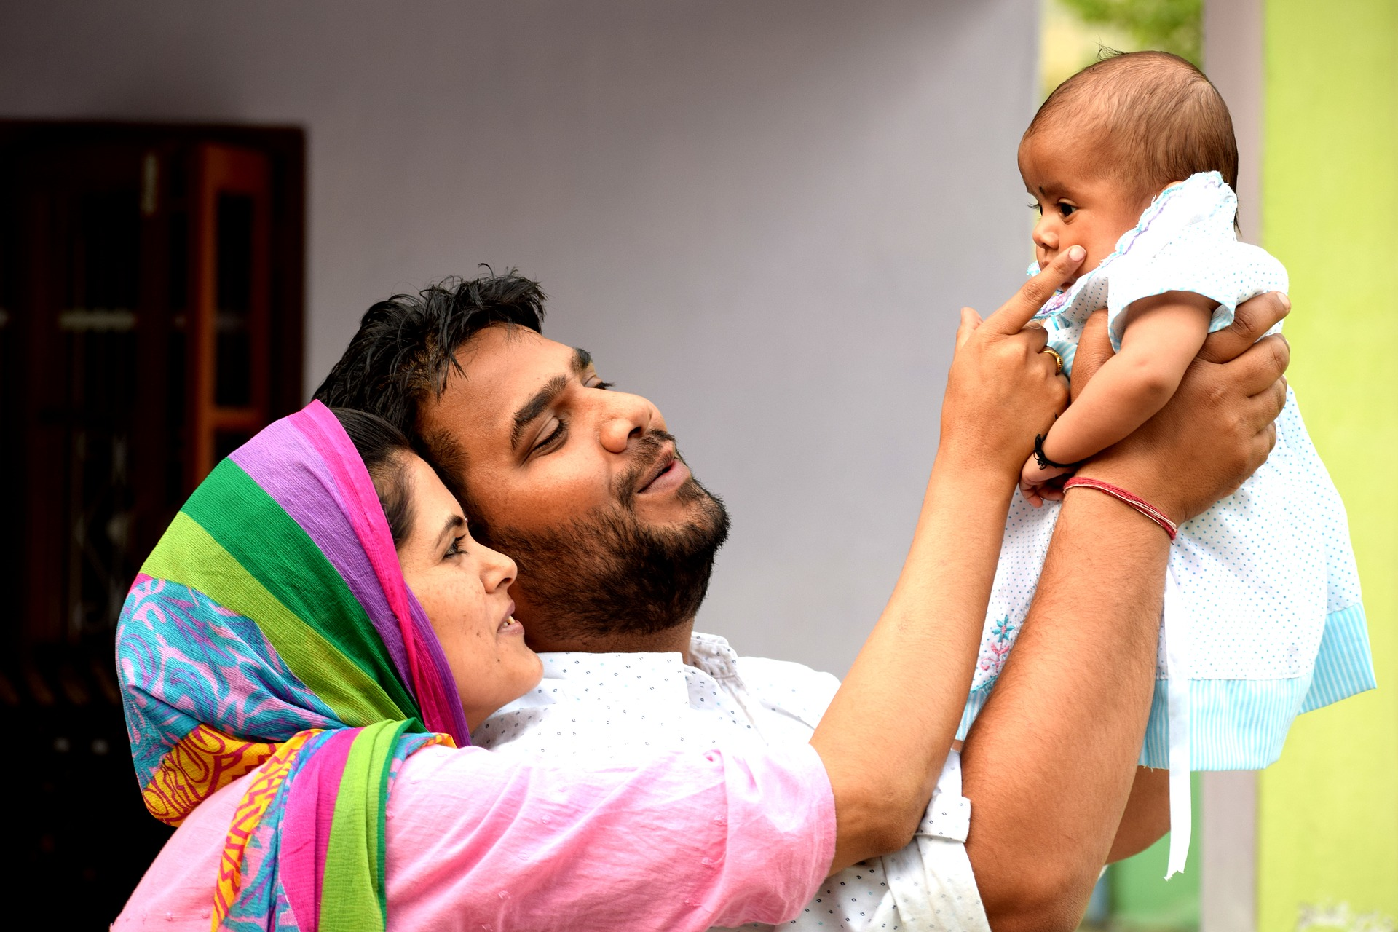
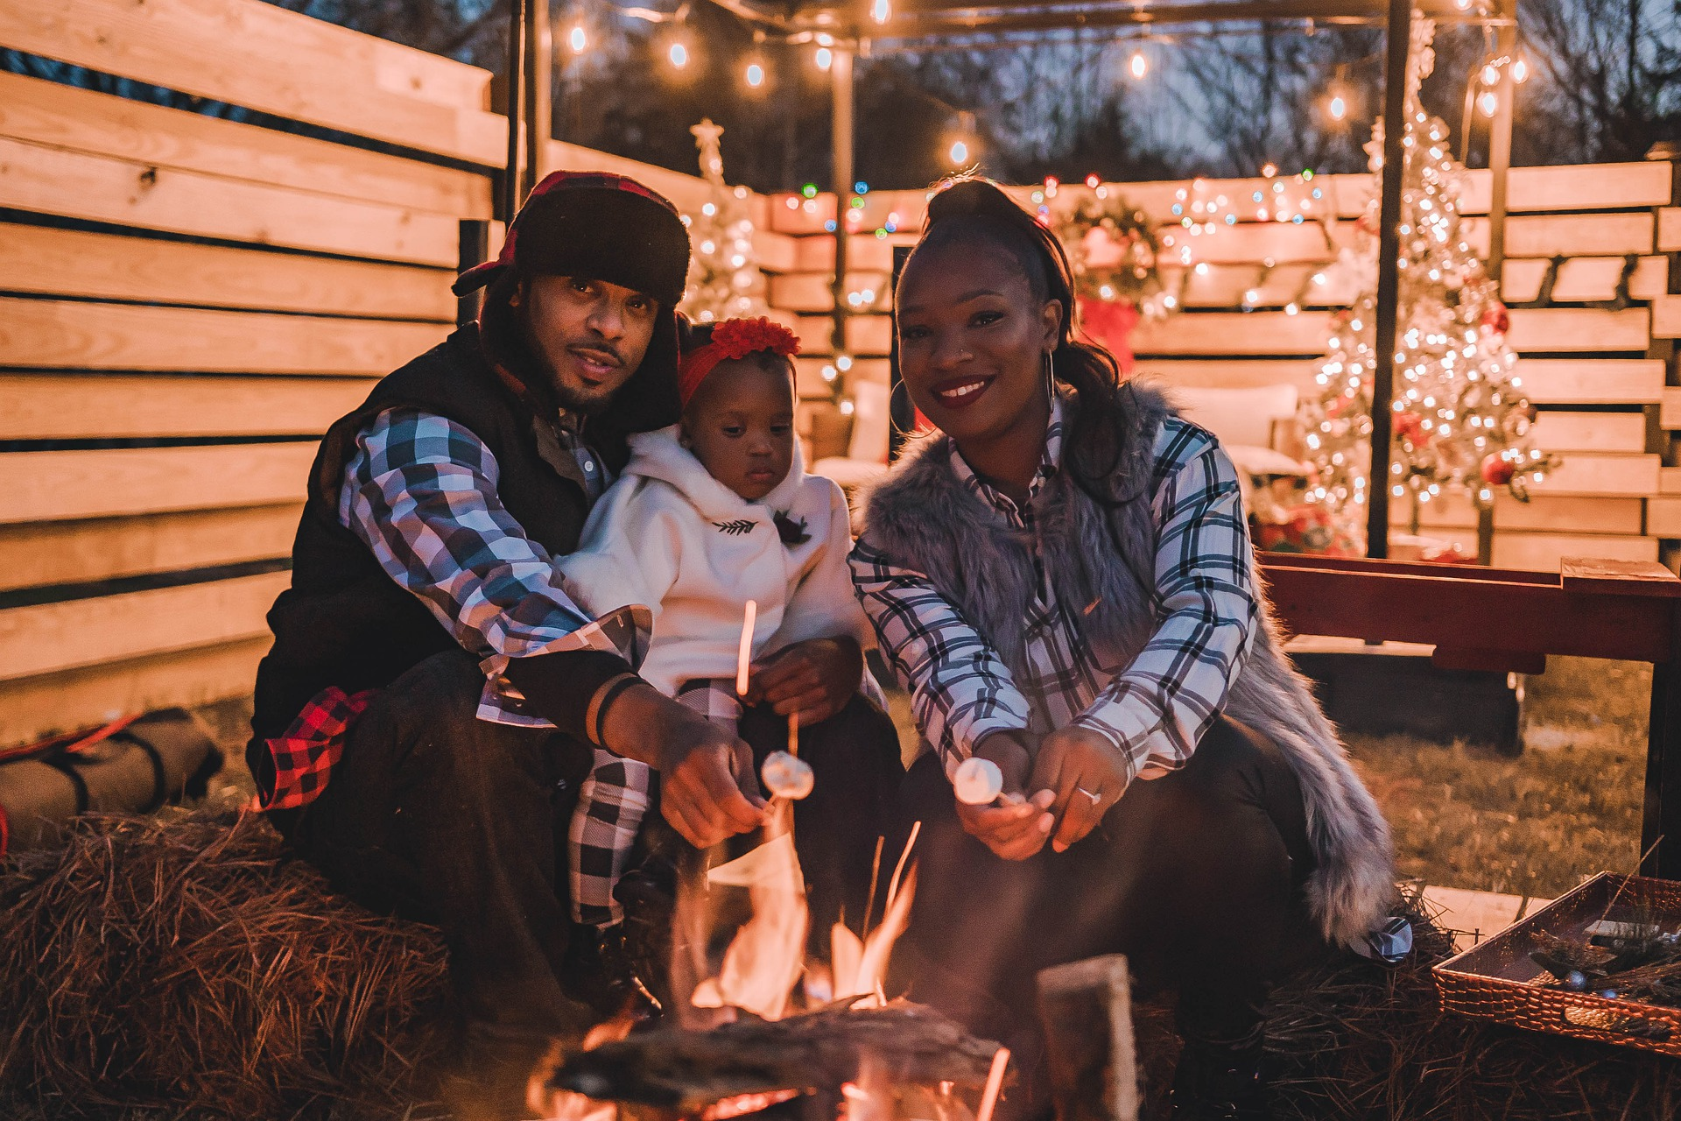
Family

Slide 5
Words to describe different families and family members
Half brother/sister
Stepmother/ father
cousins
In laws
Extended family
Nuclear family
Single parent family
Foster family
Adopted family
Notes:
Here are some possible words you may wish to teach – the slide can be edited to your group.

Slide 6
Maya’s story 2.1 My family old and new
A nuclear family An extended family A foster family An adopted family An only child A twin |  | Mother Stepmum Sister Half-sister Aunt Single parent Parent |  | Cousins Father Uncle Stepdad Brother
Listen to Maya talk about her family. As you listen tick ✓ the words you hear.

Slide 7
Maya’s family
A nuclear family
An extended family
A foster family
An only child
Mother / mum
Sister/s
Aunt/s
Parent/s
Cousins
Father/dad
Uncle/s
Brother/s
Listen to Maya talk about her family. As you listen tick ✓ the words you hear.

Slide 8
Maya’s family
Maya’s story 2.2
Listen to Maya again and decide
if the statements are T,F or NG
T=true F=false NG= not given
1.Maya has a twin brother.
2.Not many families live together like Maya did with her family in her country.
3.Maya was a lonely child.
4.Maya has always lived with the same foster family.
5.Maya wishes she lived in an extended family.
6.Maya doesn’t want to call her foster parents, mum and dad.
1.F
2.F
3.NG
4.F
5.NG
6.T

Slide 9
Writing My Family/ A family I know
type of family
different members of the family and their names
feelings about the family
relationships in the family

Slide 10
Reflection
Think about the different families you know.
Discuss what you think of different types of families. Do you think that some families are better than others? Why? Why not?

