Slide 1
Work
Developing Skills through Volunteering

Slide 2
Learning Outcomes
By the end of the lesson, you will have:
understood the difference between hard and soft skills
discussed the hard and soft skills people have developed through volunteering
discussed when and how soft skills can be developed

Slide 3
Hard Skills V Soft Skills
Hard Skills = the skills or knowledge you learn through education, training or work experience and are specific to particular roles. For example, a chef needs to know how to cook and needs a lot of knowledge about different foods.
Soft skills = people or social skills that can be used in any role, job or social situation. Examples include effective communication or working in a team.
What other examples of hard and soft skills can you think of?

Slide 4
Hard or soft skills?
*customer service *record keeping *problem solving *repairing things *training others *leadership skills *operating machinery * time management *handing money *working with different types of people *organisation of people and events *accounting *knowledge of computer software programmes *making decisions *counselling skills
Work with a partner to sort the skills/knowledge into hard and soft skills. There may be some that can be put in both boxes.

Slide 5
Hard or soft skills?
hard skills = customer service, record keeping, training people, repairing things, operating machinery, accounting, knowledge of computer software programmes
soft skills = customer service, problem solving, training people, leadership skills, working under pressure, working with different types of people, organisation of people and events, making decisions, time management
Customer service could be in both boxes: there are aspects of customer service which can be taught but at the same time, good customer service also involves ‘people skills’

Slide 6
George
I’ve been working as a voluntary finance officer. I studied accountancy in Syria but they use a different accounting system over here which I’ve had to learn. Because I understand finance, I have also been running workshops on managing your money for young people. I’ve never done any teaching before but I’ve had some useful guidance on how to organise the training to make it useful for everyone. Some of the people find the workshops difficult or lose interest easily, so it’s important to think of ways of involving everyone. There’s a lot to do and I only volunteer a few hours a week, so I have had to learn how to manage my time effectively to make sure I get everything done.

Slide 7
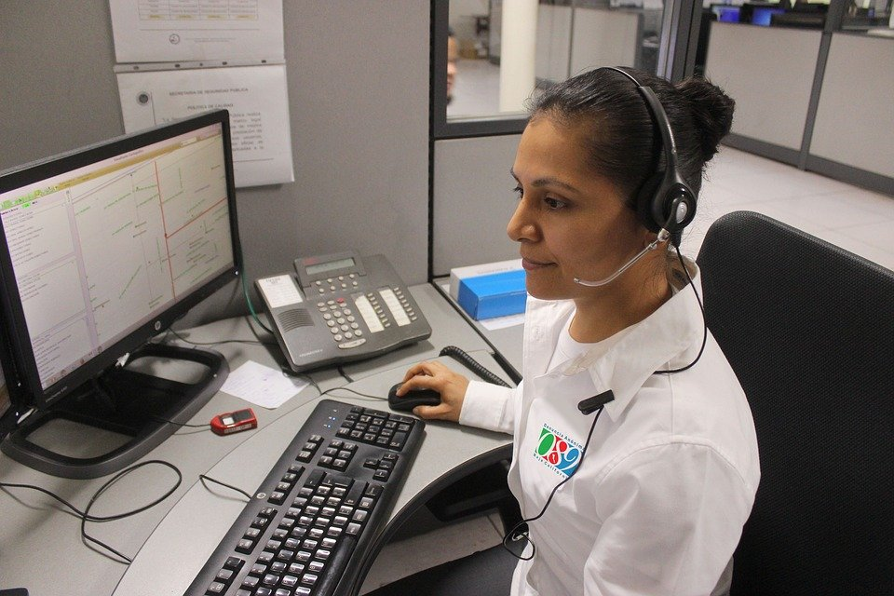
Leila
Woman
Before joining Skilling up, I had no experience of counselling but I was sent on a training course and now I’m part of a team delivering counselling sessions for young people. In fact, it was the first team I was a member of and now I am actually organising it! Counselling is challenging in many ways; it’s important to listen very carefully to what people are telling you rather than simply doing all the talking yourself!

Slide 8
Zoltan
I hate throwing things away when they don’t work. It’s such a waste. So I decided to teach myself how to repair things. Now I teach other people how to do it at Skilling Up. Local people bring us their broken things or things that don’t work and we try to work out ways of repairing them. We don’t always have an immediate answer so have to do some research to work out what to do! They give us a donation for our time and for the materials. I’ve had to learn how to set up a simple accounting system and teach the other volunteers how to use it. I’ve also learnt how to deal with our customers and the other volunteers by email, on the phone and face to face.

Slide 9
Developing soft skills
What soft skills could be developed doing these things? Why? How?
organising a party
being a good friend
cooking a meal with somebody
living together with people
doing project work at school or college
being a member of a sports/community
being a good neighbour

Slide 10
Reflection
Is it easier to develop hard or soft skills?
Why are soft skills important?
Do you feel you already have a lot of soft skills?
What can you do to develop your soft skills for the future?

