Slide 1
Health and Well-being -
At the dentist’s

Slide 2
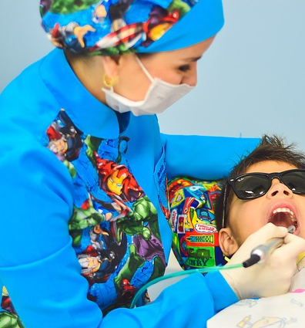
Learning Outcomes
By the end of the lesson you will have:
become aware of the importance of regular dental check-ups and dental hygiene.
shared and clarified vocabulary needed at the dentist’s.
practised making an appointment.
practised explaining problems to the dentist.

Slide 3
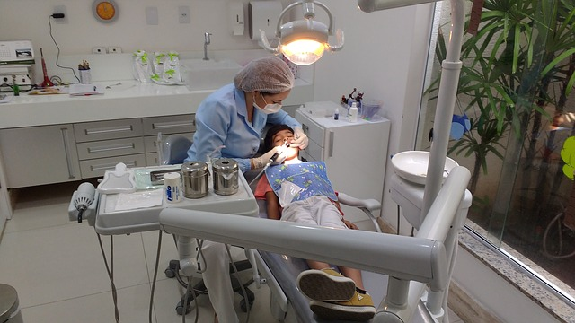
Dentists Then v Dentists Now

Slide 4
Dentist or Dental Hygienist?
Cleans the teeth.
2. Cleans dental decay and fills the tooth
Takes out diseased teeth
Polishes the teeth.
Makes false teeth or sets of dentures.
Deals with diseased gums.
Drills out the decay from teeth
8. Deals with injuries to teeth.
9. Suggests the best toothbrush to use.
10. Prepares a paste to fill the holes left by drilling.
11. Gives advice about how to clean teeth accurately.
12. Keeps records of patients’ teeth.
13. Suggests flossing, or cleaning between the teeth.
14. Takes X-rays.
15. Cleans plaque and tartar from teeth.
16. Suggests the best toothpaste to use.

Slide 5
What’s the problem? At the dentist’s. Listen!!
This Photo by Unknown Author is licensed under CC BY-SA-NC

Slide 6
Reflection
Remember that if you are not registered with a dentist, it is important to do so.
What are the advantages of going to the dentist’s regularly?
Spend some time looking for dentist’s surgeries or practices around the area where you live.
Check on the local authority website. You may be eligible for free treatment.

