Slide 1
Health and Well-being -
The Benefits of Volunteering

Slide 2
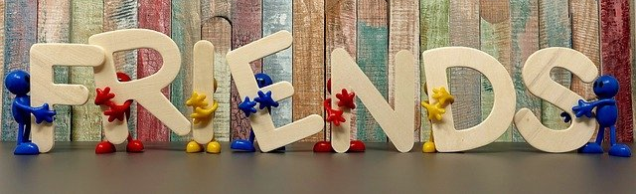
Lesson Outcomes
By the end of the lesson you will have:
thought about the kinds of volunteering people can do.
read about and discussed why people volunteer.
read about the advantages of volunteering.
discussed the pros and cons.

Slide 3
Volunteers
Amelia
I started volunteering when I was thinking about what I wanted to do after school. I was interested in conservation work so I volunteered for a Nature Trust. I started planting trees, building bird boxes and bat boxes …. I learned to do things safely and built up my base knowledge. Networking is a big thing in the environmental sector. I’ve made so many friends, feel much happier and more self-confident. I’m now an apprentice conservation officer.
Callum
… I wake up at 5am to work on the farm, collect water and build relationships in the community. The voluntary sector is a perfect chance for young people to gain experience and make themselves employable. I work very long hours, but I’m stronger, mentally and physically, independent of my family, able to make decisions for myself.
I’m often tired, but now I know the experience has made me happier and feel fulfilled.
Megan
I always wanted to work in the theatre so I volunteered as an usher at the Lyric theatre in Dublin. Now I’ve been taken on as an assistant working with children’s theatre. My advice is: be smart, find out what you’re good at, and decide how you learn best. And never give up!!
Tanveer
I’m a volunteer worker for the local authorities. I’m a support teacher for students needing any kind of help with online learning. I’m using my own computer skills to help others learn them.

Slide 4
Volunteers
Ettore
I started just by phoning people who live alone in our local community. I was a scout so I understand the meaning of volunteering and helping out. I saw an ad in the newspaper posted by the local authorities. I was scared at first. Then I began distributing food coupons using a scooter, but now I have 350 contacts and have made lots of new friends. My language has improved and so has my skill at understanding and helping people. I offer friendship and advice too. I think that doing good does you good!
Ali
I deliver medications and shopping to the elderly and infirm in the area where I live. I have a motorcycle to get around on and I can now use it in the traffic with confidence. I feel good about what I’m doing. I’m out in all weathers but my new friends wait for me to arrive every day and I’m happy for that.

Slide 5
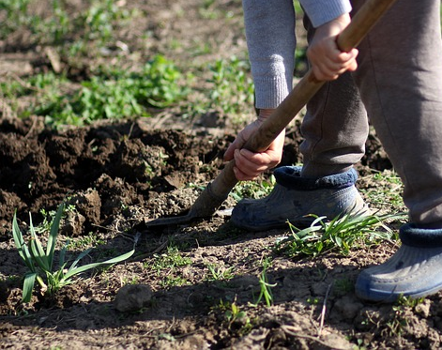
Who …. ?
… volunteered as an usher at the theatre?
… wakes up at 5am?
… saw an ad in the local paper?
… has learned to do things safely?
… is out in all weathers?
… distributes food coupons?
… is now working in children’s theatre?
… was scared at first?
… is using his skills to teach others?

Slide 6
Health Benefits of volunteering Key findings on mental health and well-being, physical health, social connections and employability
Volunteering:
improves mental and physical well-being.
increases self-esteem (self-confidence).
increases happiness.
gives greater life satisfaction.
reduces depression.
improves functional ability.
improves social connections.
helps you to make friends.
increases feelings of being appreciated.
can improve skills including soft skills such as teamwork.
can prepare you with skills useful for work.
boosts the immune system.

Slide 7
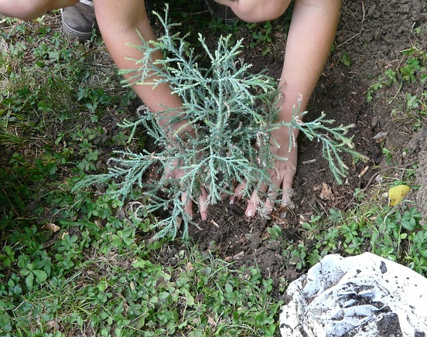
Reflection
Do you agree with the health benefits of volunteering?
“Doing good does you good” Do you agree with Ettore?
Should you be paid for the work you do?
“Never give up”. Do you agree with Megan? Why? Why not?
“Volunteer to career”. Possible or impossible?

