Slide 1
Health and Wellbeing
Sleeping Well

Slide 2
Lesson Objectives
By the end of the lesson you will have:
talked about things that help and don’t help you sleep.
listened to a TED Talk – 6 tips for better sleep.
researched what support there is in your area for people who have difficulties sleeping.

Slide 3
Are these going to help you sleep or not?

Slide 4
Guess the word
1. Iomnnsai | Insomnia
2. resdsakn | darkness
3. euapmerrtet | temperature
4. iggrert | trigger
5. eiacffen | caffeine
6. ihoaolc | alcohol
7. laruegr | regular
8. liaemnotn | melatonin
9. lsepe anaepo | sleep apnoea
Notes:
Second column answers are there in white. Select and change colour of font for answers.

Slide 5
6 tips for better sleep
Tip 1
Tip 2
Tip 3
Tip 4
Tip 5
Tip 6

Slide 6
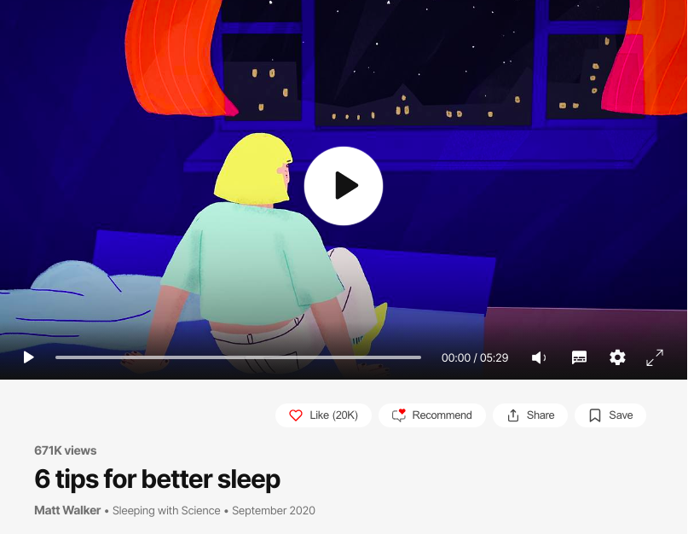

Slide 7
True or false?
1.You should change the time you go to bed each night
2. You shouldn’t sleep in a very cold room.
3. You should wear an eye mask.
4. You shouldn’t stay in bed if you can’t get to sleep straight away
5. You shouldn’t have alcohol or coffee before going to bed
6. You should see a professional if you have problems going to sleep
1.F 2.T 3.F 4.F 5 F. 6. T

Slide 8
Research

Slide 9
Reflection
Do you think you might change your bedtime routine to help you sleep better? Why? Why not?
Many people find it difficult to sleep, what advice can you give to someone who can’t sleep well?
There is a lot of support available for people who find it difficult to sleep. Have you heard of any of the organisations? What do you think of the support/ organisations?

