Slide 1
Relationships
Marriage

Slide 2
Lesson Objectives
By the end of the lesson you will have:
looked at some of the different types of weddings people have
talked about some of the changes we are seeing in marriages
exchanged views on what makes a successful relationship

Slide 3
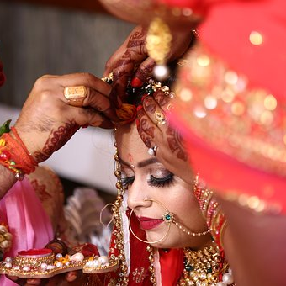
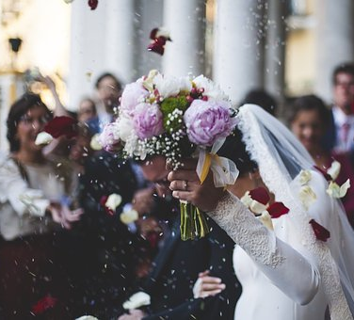
Your views
What words do you think of when you look at the photos?
How do you feel when you look at the photos?

Slide 4
Discussion Questions
Why are fewer people getting married nowadays?
What are the advantages and disadvantages of arranged marriages?
Why are non-religious ceremonies becoming more popular?

Slide 5
Language Box: Making deductions When you are quite sure …must be… For example: It must be difficult marrying somebody you do not know very well. When it is a possibility …might be… …could be… …may be… For example: It might be because people do not think marriage is that important. When you do not think it is possible …can’t be… For example: It can’t be easy for parents who are very religious see their children have a non-religious ceremony.

Slide 6
Why are fewer people getting married nowadays?
b) People would rather spend their money on other things like buying a house together.
e) In the past married couples paid less tax in some countries.
g) It has become more acceptable to live with someone and not be married.

Slide 7
What are the advantages and disadvantages of arranged marriages?
You do not have to pay for a dating agency to find a partner.
Sometimes people agree to marry someone only to make their parents happy.
i) The person you are matched with is someone your family usually likes.

Slide 8
Why are non-religious ceremonies becoming more popular?
There are more people of different religions marrying each other.
d) Some churches ask couples to attend marriage classes before they get married.
h) The wedding can be more personalised.

Slide 9
Discussion Questions
Relationships are unlikely to be successful when there is an age difference.
Couples who meet at a young age do not stay married very long.
People who get divorced are likely to remarry.
Families with children are less likely to split up.
When you have been married for over 15 years, you are very likely to stay with your partner forever.

