Slide 1
Health and Wellbeing
Depression

Slide 2
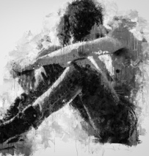
Learning Outcomes
By the end of the lesson, you will have:
discussed facts and myths about depression
looked at different symptoms of depression
watched and discussed a short video about depression

Slide 3
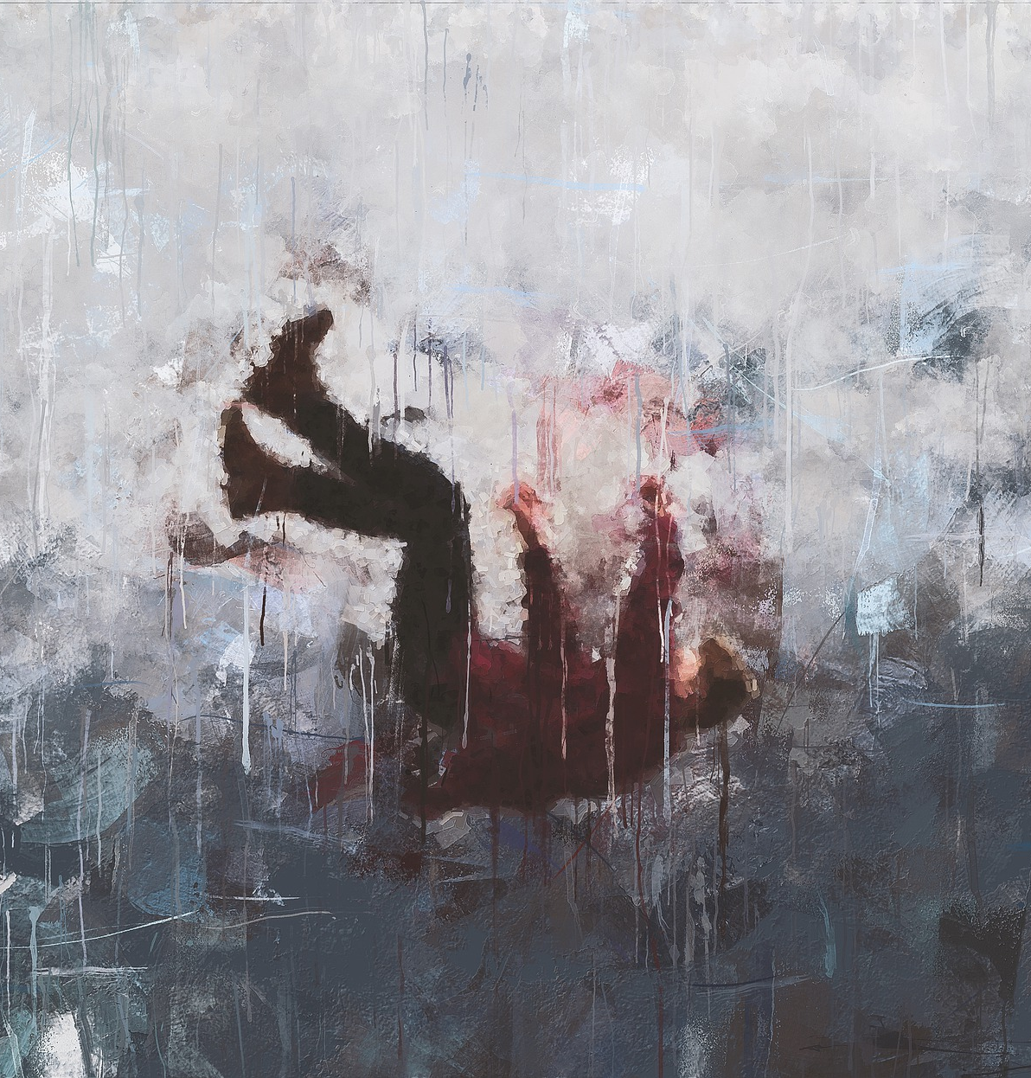
What is Depression?
It affects 5% of the population in the EU.
3 out of 4 people do not receive or seek professional help.

Slide 4
Language Box: Speculating
My guess is that this is true/ false because... | It’s probably true/ false because...
I wouldn’t be surprised if this is true/false because... This is likely to be true/false because... | I imagine this is true/ false because... I bet this is true/ false because...

Slide 5
What do you think? Are the comments true or false?
“I think someone who is sad knows what they are sad about. They can explain their sadness. They understand why they are sad.”
“I think a depressed person can explain their mood. They know what is making them depressed.”
“I read that the best thing for depression is medication.”
“Apparently, psychotherapy can help someone who is depressed.”
“Depression only affects women, doesn’t it?”
“Sadness is the same as depression, isn’t it?”
“Depression just does not run in your family. If someone is depressed in your family, it doesn’t mean that you will suffer from depression.”
“If you’re depressed, I reckon you need to think positive thoughts and change your attitude and you’ll feel better.”
“Why does everyone take depression so seriously? It isn’t a real illness!”

Slide 6
Are these symptoms psychological, physical or social?
no motivation or interest in life difficulty sleeping
avoiding events unable to make decisions
feeling irritable not seeing friends moving more slowly
a change in appetite having suicidal thoughts
continuous low mood a change in looks being difficult to be around
feeling negative tired
not doing well at work/school no interest in activities/hobbies

Slide 7
Psychological no motivation or interest in life continuous low mood Feeling irritable Feeling negative unable to make decisions having suicidal thoughts | Physical Moving more slowly change in appetite change in looks tired difficulty sleeping | Social not seeing friends being difficult to be around avoiding events no interest in activities or hobbies (no pleasure in activities) not doing well at work/school

Slide 8
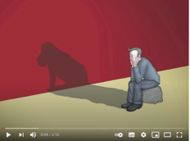
I Had a Black Dog. His Name was Depression
You’re going to watch a short video about depression. The narrator mentions many symptoms of depression. Tick the symptoms he mentions in Activity 3.
https://www.youtube.com/watch?v=XiCrniLQGYc

Slide 9
I Had a Black Dog. His Name was Depression
Psychological- feeling irritable, feeling negative
Physical Moving more slowly
change in appetite (ruin your appetite) change in looks (looking older) tired (exhausted)
Social no interest in activities or hobbies ( no pleasure in activities)
https://www.youtube.com/watch?v=XiCrniLQGYc

Slide 10
I Had a Black Dog. His Name was Depression
seek professional help; keep a mood journal; talk to people, the right people; be open to those close to you; do regular exercise; keep track of what you’re grateful for; don’t run away from your problems; ask for help don’t feel ashamed
https://www.youtube.com/watch?v=XiCrniLQGYc

Slide 11
Reflection
.
Why do you think some people find it hard to talk about depression? Do you think it’s easy to talk about depression where you live now? Why?
How would you feel if someone close to you told you they were suffering from depression? What would you say?
Do you feel it is easier for men or women to talk about depression? Why do you think this?
What advice would you give to someone new to the country who was suffering from depression?

