Slide 1
Problem-solving -
Two brothers journey to Europe

Slide 2
Lesson Outcomes:
By the end of the lesson students will have:
thought about having to go away from home.
watched a real-life situation of young people fleeing their home country.
imagined the journey they had to make and what they can do in the future.

Slide 3
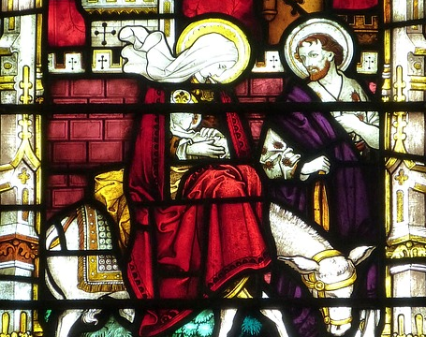
Introduction:
Have any of you had any experience of living away from your family?
Has anyone actually had to leave home for any reason?
How did you feel about it?

Slide 4
Watch the video about Ali and Ahmed. Read the subtitles.
https://youtu.be/-QlHUcXQhf0
This Photo by Unknown Author is licensed under CC BY-NC

Slide 5
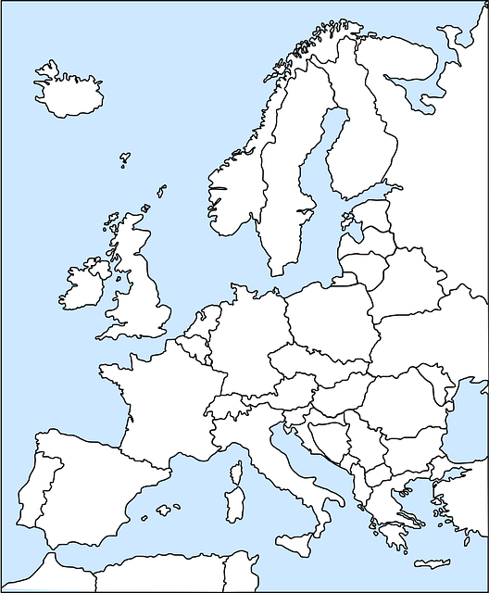
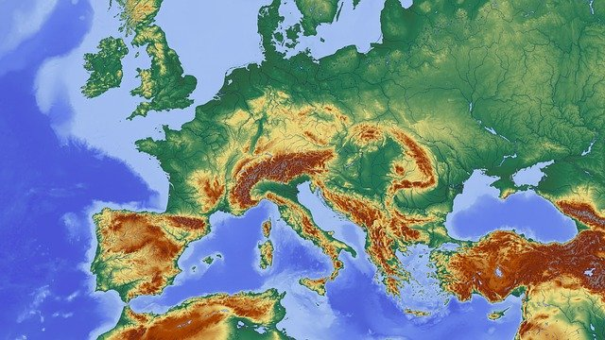
Ali and Ahmed’s journey to Germany

Slide 6
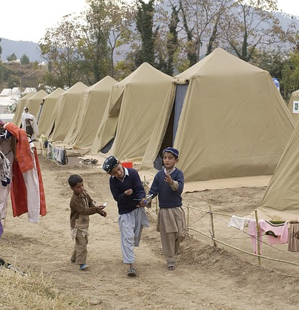
Getting there and finding a place to stay!

Slide 7
What can they do now?
Study
work
volunteer
find somewhere to live
make friends

Slide 8
Reflection
Do you feel sympathy for Ali and Ahmed?
Why? Why not?
How would you feel in their position?
Would you do the same?
What would you do differently and why?
How difficult is their life going to be, do you think?

